Slide 1
APHG vocab review
Key terms and study strategies

Slide 2
Overview
Strategies for reviewing vocab on your own
Online study resources related to key concepts
Need-to-know vocabulary for each unit of the course

Slide 3
Vocabulary review strategies
Flash cards (study partner; make your own; Quizlet; Studystack)
Quiz yourself
Review vocabulary list using process-of-elimination
Review games (iScore5 app)
Find examples for difficult terms and key concepts, both to help you understand them and to provide detail on FRQs as necessary
My AP Classroom Daily Videos
Repetition, repetition, repetition

Slide 4
Graphic organizers: Frayer model & visual dictionary
Frayer model
Visual dictionary
Antonym | Rhyme | Illustration
Meaning | TERM | Example
Synonyms | In Syllables | Used in a Sentence

Slide 5
Need-to-know vocab Scale
"Scale" has multiple meanings:
Methodological scale (scale at which we collect data and ask questions)
Map scale (relationship of a feature's size on the map with actual size on Earth)
Geographers often discuss space and place using local, regional, and/or global scales. Some issues are even "glocal."

Slide 6
Visual stimulus question: Scale
How is map scale represented in this image?

Slide 7
Need-to-know vocab Demographic Transition Model (DTM)
The DTM illustrates the connections between population change and economic development.
Melds data on birth rate, death rate, and total population.

Slide 8
Visual stimulus question: DTM
Based on the population pyramids on the right, which stage of the DTM is Uganda likely in? Italy?

Slide 9
Need-to-know vocab Cultural diffusion
The movement of people, ideas, or things from one location to new locations
Types of diffusion include:
-Relocation diffusion
-Expansion diffusion
-Hierarchical diffusion
-Contagious diffusion
-Stimulus diffusion

Slide 10
Visual stimulus question: Diffusion
Which form of diffusion is best represented by this image of Pilgrims landing at Plymouth, Mass. In 1620?

Slide 11
Need-to-know vocab Globalization
"The world is shrinking"
Because of globalization, the world is becoming more uniform, integrated, and interdependent
Cultural, economic, and political dimensions of globalization
Global-local tensions express themselves in many ways

Slide 12
Visual stimulus question: Globalization
Lady Gaga cancelled a concert in Jakarta, Indonesia in 2012, citing security concerns following protests by religious groups. This illustrates:
Inability of globalization to penetrate developing countries
Tensions between global and local cultural forces
The influence of supranational organizations
Economic globalization
The decline of transnational corporations

Slide 13
Need-to-know vocab Subsistence & commercial agriculture
Subsistence agriculture (LDCs): production of food primarily for consumption by the farmer’s family
Commercial agriculture (MDCs): production of food primarily for sale off the farm
Five distinguishing features:
1) Purpose of farming
2) Percentage of farmers in the labor force
3) Use of machinery
4) Farm size
5) Relationship of farming to other businesses

Slide 14
Visual stimulus question: Agriculture
Which form of agriculture is best represented here?
Plantation farming
Pastoral nomadism
Shifting cultivation
Ranching
Mixed livestock & crop cultivation

Slide 15
Need-to-know vocab Central Business District (CBD)
Refers to the commercial heart of a city, and is a key feature in most urban land use models.
Competition for limited space in the CBD leads to higher land costs, taller buildings, high-density housing and commercial activity.

Slide 16
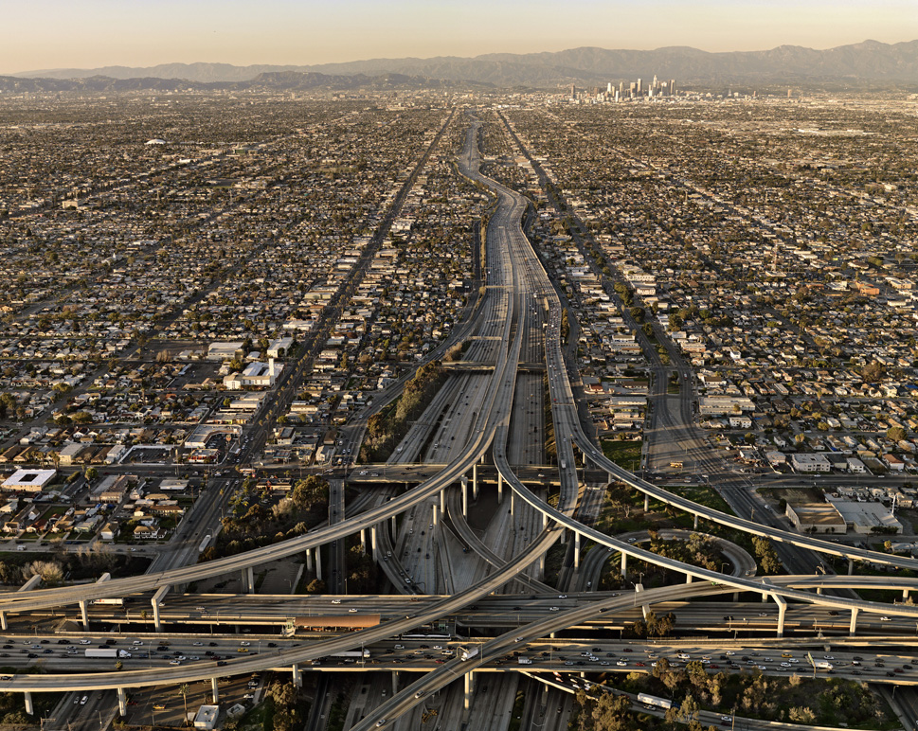
Visual stimulus question: Where is the CBD?
D
A
C
B

Slide 17
Need-to-know vocab [Economic sectors & activities]
Primary: extract/harvest natural resources
Secondary: process, manufacturing, package assemble
Tertiary: Sales & services
Quaternary: knowledge-based services
Quinary: highest levels of decision-making

Slide 18
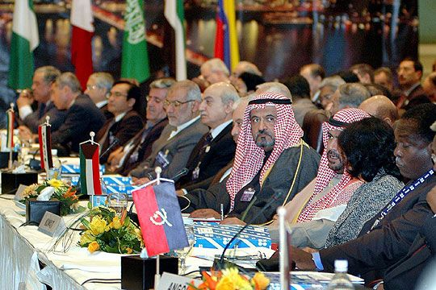
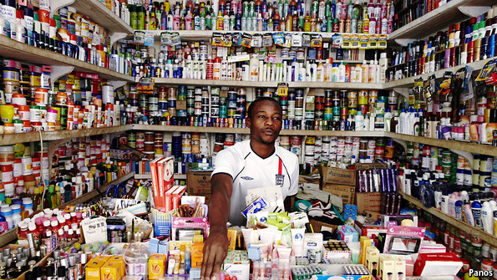
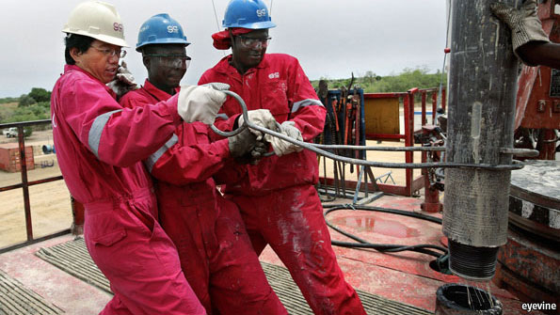
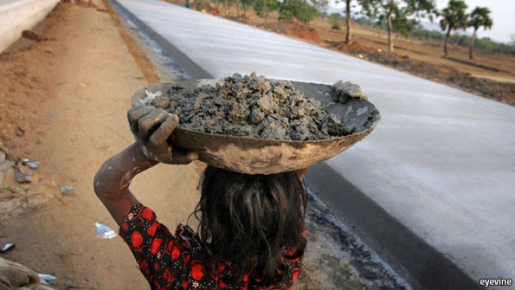
Visual stimulus: Identify each economic sector by activity

Slide 19
Visual stimulus: Identify each economic sector by activity
3
5
1
4
2

