Slide 1
AP Human Geography Models

Slide 2
Demographic Transition Model

Slide 3
Epidemiological Transition Model

Slide 4
Von Thunen Model

Slide 5
Concentric Zone Model
Ernest Burgess
1923
Isolated plain
Chicago

Slide 6
Concentric Zone Model by Burgess

Slide 7
Sector Model
Homer Hoyt
1939
Isolated plain
Chicago

Slide 8
Sector Model by Hoyt

Slide 9
Multiple Nuclei Model
Chauncey Harris and Edward Ullman
1945
Isolated plain
Los Angeles

Slide 10
Multiple Nuclei Model by Harris and Ullman

Slide 11
Galactic Model
Chauncey Harris
1960’s
Isolated plain
Detroit
Edge Cities

Slide 13
Latin American City Model
Ernest Griffin and Larry Ford
1980
Latin American cities--- Panama
Laws of the Indies
Grid
Central plaza
Church (Roman Catholic)
Shade

Slide 15
T.G. McGee
1980

Slide 16
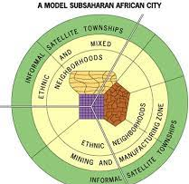
African City Model
Harm De Blij
Purple-Colonial CBD
Yellow-Traditional CBD
Brown-Open Air Markets
Sub-Saharan Africa
Colonization
Lots of Changes since independence

Slide 17
Cristaller

