Slide 1
A Brief History of Geopolitics
Geopolitics: The study of the interplay between political relations and the territorial context in which they occur.

Slide 2
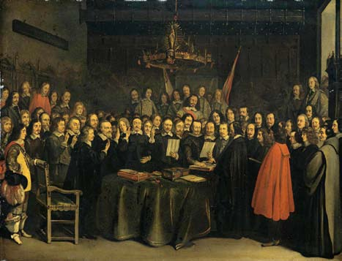
Key Event: The Peace of Westphalia
Ended the Thirty Years’ War between Protestants and Catholics in 1648
Allowed leaders to establish the official religions of their territories
Basis for modern idea of sovereign states

Slide 3
Sovereignty & self-determination
Sovereignty: the right of a government to exercise power over its people and territory
Self-determination: Free choice of a state’s own actions without external compulsion. A nation’s ability to decide its own future
July 2011: The South leaves Sudan

Slide 4
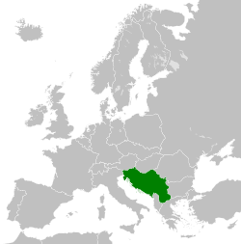
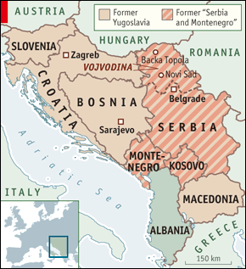
Centrifugal forces pull countries apart
Territorial disputes
Ethnic strife
Regionalism the breaking up of an area into autonomous regions
Balkanization refers to the process by which a state may break up into smaller countries.
Notes:
F for fragment.

Slide 5
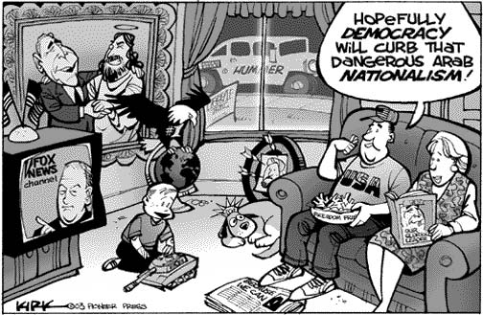
Centripetal forces unite countries
Good institutions
Symbols of national pride, loyalty, history
Strong traditions/values
Transportation & communication systems
Strong central government
Nationalism:
That one’s country should be cohesive and have autonomy
Nationalism also has negative associations with militarism & racism
Notes:
T for together.

Slide 6
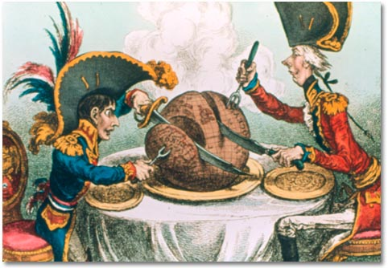
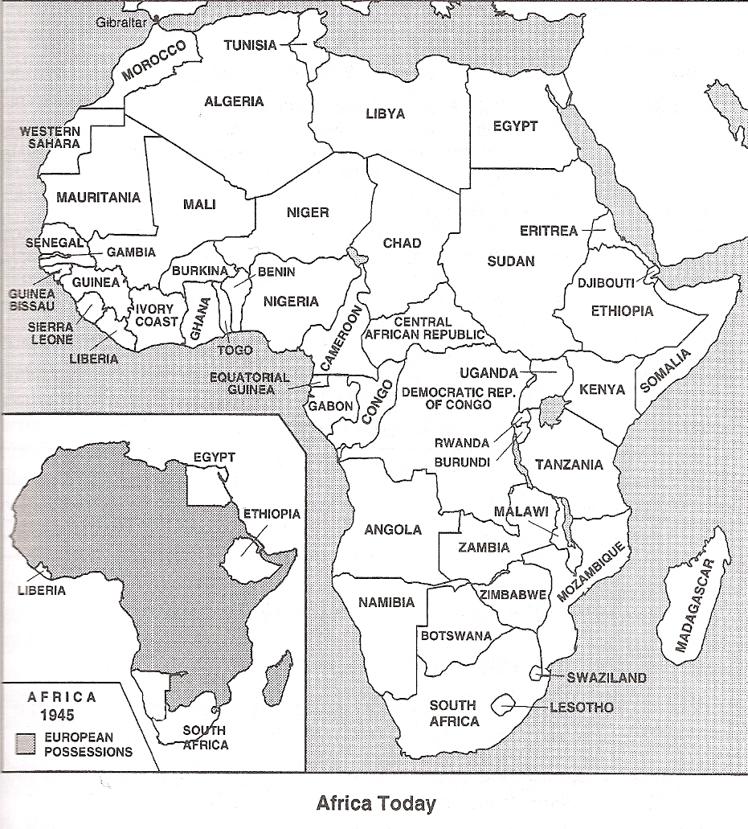
Colonialism
Expansion and perpetuation of an empire.
Most important geopolitical force of the last 500 years
Many European countries, Russia, China, Japan
Ancient: Rome, Greece, Aztecs
While colonialism involves official government rule of one state over another, imperialism describes cultural and economic dominance
Have self-determination, but often remain dependent

Slide 7
Theories of international political geography
Organic theory (Ratzel) proposes that nations must expand their land base to stay vibrant.
Hitler’s expansionist lebensraum theory
Irredentism: wishing to incorporate a neighboring state’s territory due to ethnic or cultural ties
Heartland theory (Halford Mackinder, 1904) saw Central Asia as the “pivot” point of all human history
Nicholas Spykman (1944) proposed that the surrounding coastal “rimland” area was most important

Slide 8
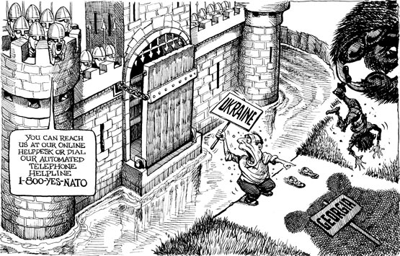
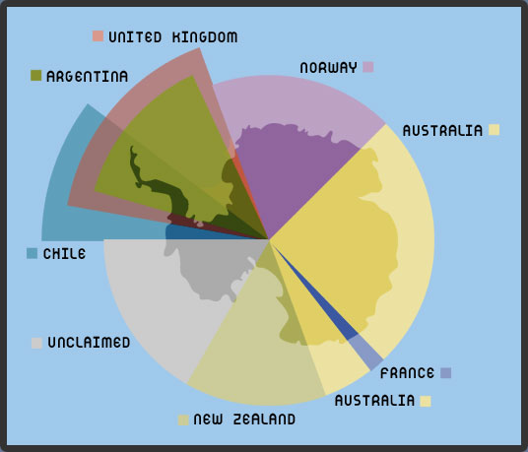
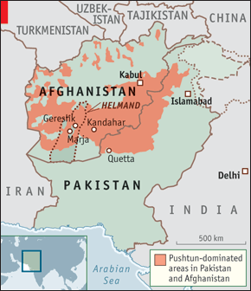
Frontier
Frontier: Area where borders are shifting and weak where peoples of different cultures meet to lay claim to the land
May be filled by buffer states (smaller states sandwiched between larger, potentially opposing countries)

Slide 9
Key Event: The Cold War (1945-1989)
East/West divide
Creation of competing alliances:
NATO (US & allies)
Warsaw Pact (Soviet Union & allies)
Both sides made attempts to provoke coups and separatist movements in other countries.
Sent radio transmissions into Eastern Europe to communicate benefits of democracy & capitalism

Slide 10
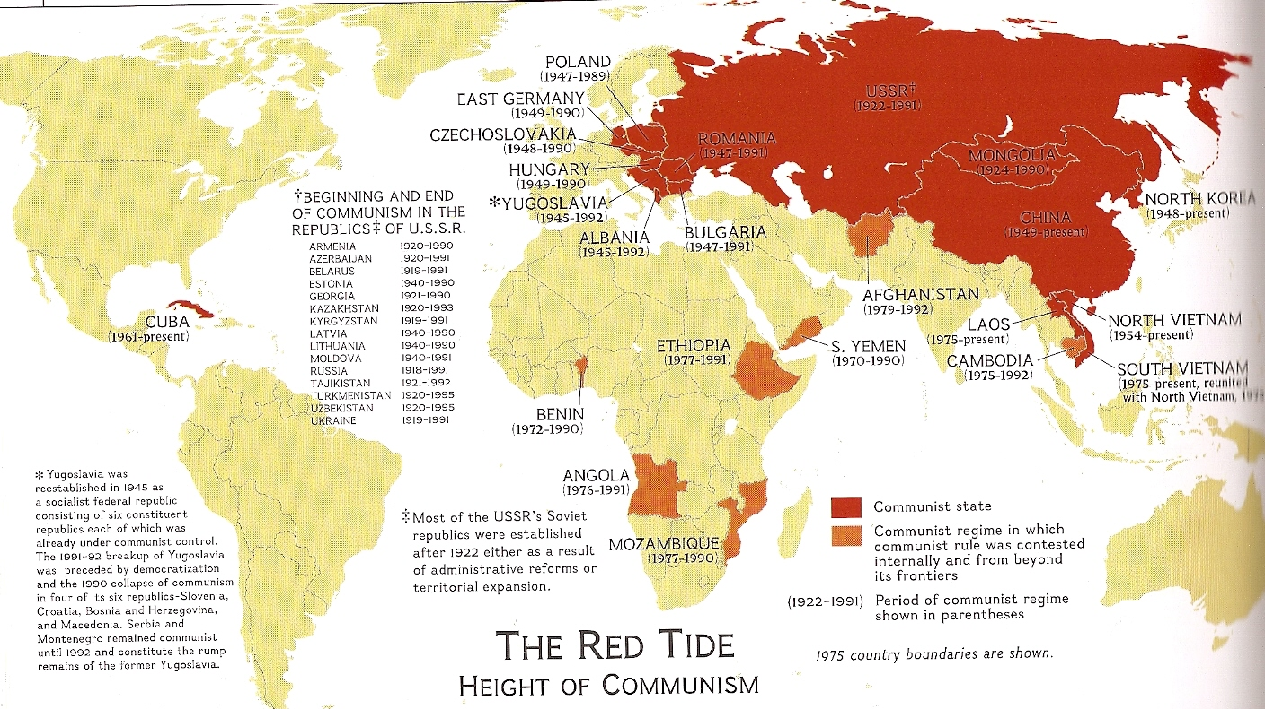
Cold War: Communist states

Slide 11
Alfred Sauvy, French demographer (1952)
First World: industrialized, free market (capitalist) countries of NATO and their allies
Western Europe, Japan, Australia, US
Second World: industrialized, centrally controlled (communist-socialist) countries
Soviet Union, Eastern Europe, China
Third World: developing countries not allied w/ 1st or 2nd World
Developing nations of Africa, Asia, Latin America
Fourth World: least developed states, or indigenous groups living within a country.

Slide 12
Cold War details
Domino theory: Concern by Western leaders that if communism caught on in a few key countries, other nearby countries would follow
Satellite states: Eastern European countries funded/controlled by the Soviet Union.
Created a “Iron Curtain” (cultural wall) dividing democratic, capitalist Western Europe from totalitarian, communist Eastern Europe
Some regions became “shatterbelts” as they got caught between the US and USSR, resulting in changing boundaries. (also Middle East & Central America)
Soviet collapse led to geopolitical reorganization
Notes:
Buffer states

Slide 13
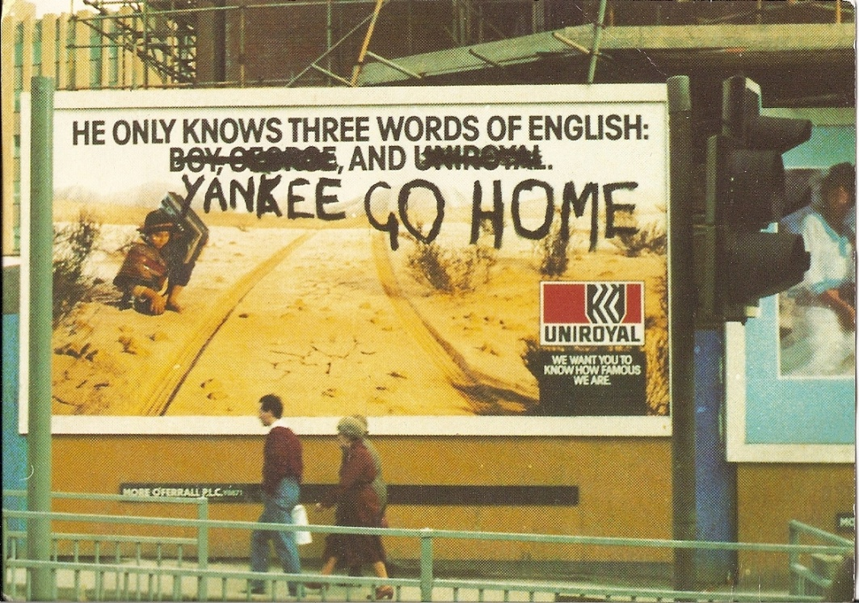
The North/South Divide
Wealthy countries of Europe and North America (plus Japan, Australia)
“Global North”
Poorer countries of Asia, Africa, Latin America
“Global South”
Mainly economic, not ideological

Slide 14
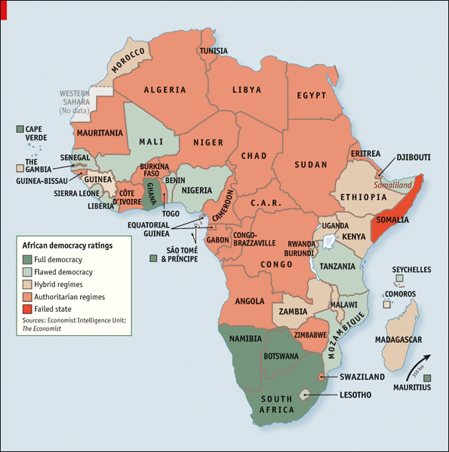
Democratization
The process of establishing representative and accountable governments led by popularly elected officials
A central goal of US diplomacy and international organizations

