Slide 1
Agriculture

Slide 2
Von Thunen Model

Slide 3
Von Thunen
Region: Germanic Duchies
Time Period: 1820’s
Observed pattern of agriculture
Featureless Plain/Isotropic Surface
Isolated State

Slide 4
Von Thunen Model Grain Farming Market Gardening Market Grazing Forest Dairy

Slide 6
Von Thunen Model
What are the 2 basic factors in determining location of agricultural activity?
Transportation and Land Cost
Why is his model important?
First model of its type to attempt to predict and analyze economic activity based on spatial considerations
How useful is it today? Or Explain the degree to which it is useful today.
https://www.thoughtco.com/von-thunen-model-1435806

Slide 7
First Agricultural Revolution

Slide 8
First Agricultural Revolution
No Pitchforks
No storming the palace
Abandoning Hunting & Gathering
Selecting plants to grow
Selecting animals to tame and control
Domestication means much more than taming
More predictable food supply
Enabled differentiation of labor
Social strata
Development of cities

Slide 9
Second Agricultural Revolution

Slide 10
Second Agricultural Revolution
Still no farmers storming the governor’s mansion
Goes with the Industrial Revolution
Jethro Tull – Seed Drill
Cyrus McCormick – Reaper
John Deere – Steel bottom plow
Produce more food
Less hand labor needed
Bigger farms
Urbanization

Slide 11
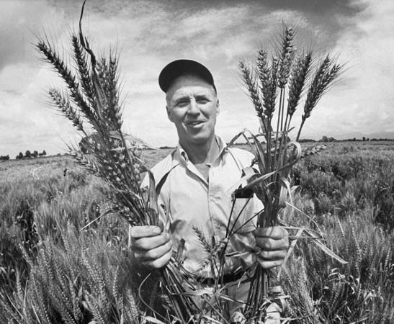
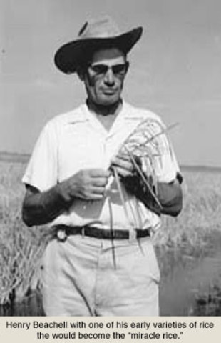
Third Agricultural Revolution

Slide 12
Third Agricultural Revolution
Also known as the Green Revolution
Norman Borlaug and Henry Beachell – plant breeding
Commercial fertilizers
Commercial herbicides
Commercial pesticides
Food production increased by 4 to 10 fold
Millions saved from starvation

Slide 13
Fourth Agricultural Revolution

Slide 14
Fourth Agricultural Revolution

Slide 15
Fourth Agricultural Revolution
Some view this as an extension of the 3rd Ag Rev
High Tech
Use of GPS
Use of Computers to map and regulate
Genetically Modified Organisms
Cloning
Produce crops and animals that can withstand extremes and still produce

Slide 16
Positives and Negatives
What are the positive aspects of
First
Second
Third
Fourth
What are the negative aspects of
First
Second
Third
Fourth

