Slide 1
Map Projections
Representing Earth in 2D

Slide 2
Map projection
A map projection is a way to flatten the Earth’s surface in order to make a map
All projections distort the surface of the Earth in some way. Globes do not.
Depending on the map’s purpose, some types of distortion are more acceptable than others. Different projections suit different purposes.
Every map uses a projection that stays true to the properties that are most important to its purpose, while allowing distortion of other properties.
Properties of maps which might be preserved or distorted include area, bearing, direction, distance, and shape.
Ex. Preserving shape can distort scale and bearing

Slide 3
An example of distortion: Colorado on Mercatur projection

Slide 4
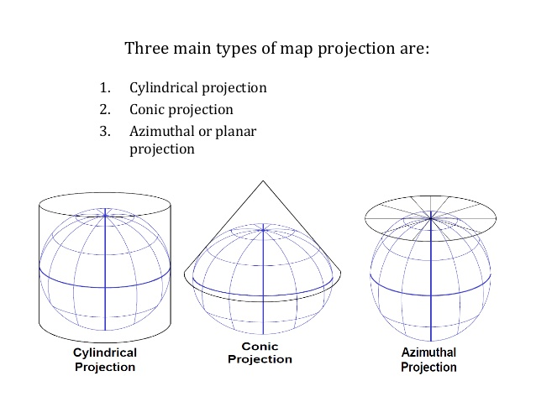

Slide 5
Mercator projection
Developed for sea navigation.
Accurately shows shape and direction, but distorts distance and size of places (especially near poles)

Slide 6
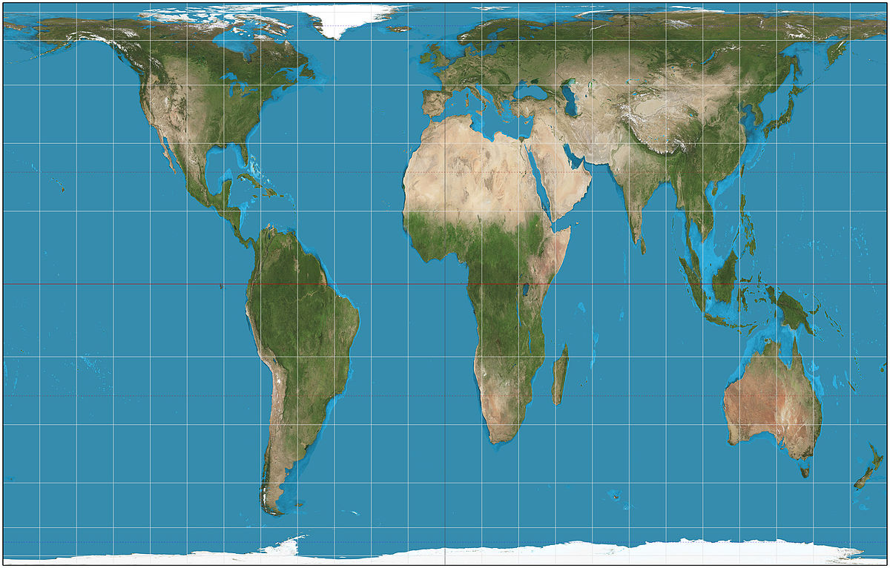
Gall-Peters projection
Focuses on true area or size of land masses, but distorts shape.

Slide 7
Robinson projection
A “compromise projection” that attempts to minimize several typical projection errors in shape, size, direction or distance.
Used by National Geographic until 1998.

Slide 8
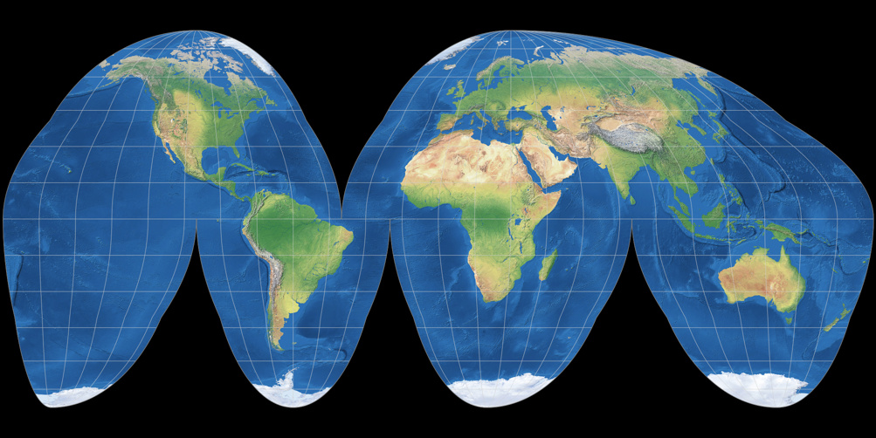
Goode’s homolosine projection
Shapes and sizes of landmasses are accurately shown by cutting through the oceans like an orange peel.

Slide 9
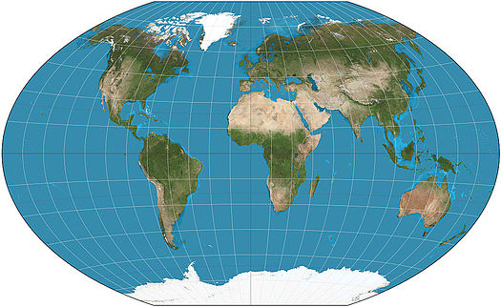
Winkel Tripel projection
Minimizes distortion in size, direction, and distance.
Lines of latitude are slightly curved and nonparallel.
“Compromise” projection adopted by National Geographic in 1998.

Slide 10
Mollweide projection
Shows area accurately, but directions and shapes are distorted at the edges.
Meridians converge at the poles.

Slide 11
Projection | Purpose | Strengths | Distortion
Mercator | Navigation | Directions are shown accurately Lines of latitude and longitude meet at right angles | Distance between lines of longitude appear constant Land masses near the poles appear large
Peters | Spatial Distributions Related to Area | Sizes of land masses are accurate | Shapes are inaccurate, especially near the poles
Conic | General Use in Midlatitude Countries | Lines of longitude converge Lines of latitude are curved Size and shape are both close to reality | Distance is not constant On a world map, longitude lines converge only at one pole
Robinson | General Use | No major distortion Oval shape appears more like a globe than does a rectangle | Area, shape, size and direction are all slightly distorted
Notes:
Adapted from AMSCO Advanced Placement Human Geography, David Palmer 2019

Slide 12
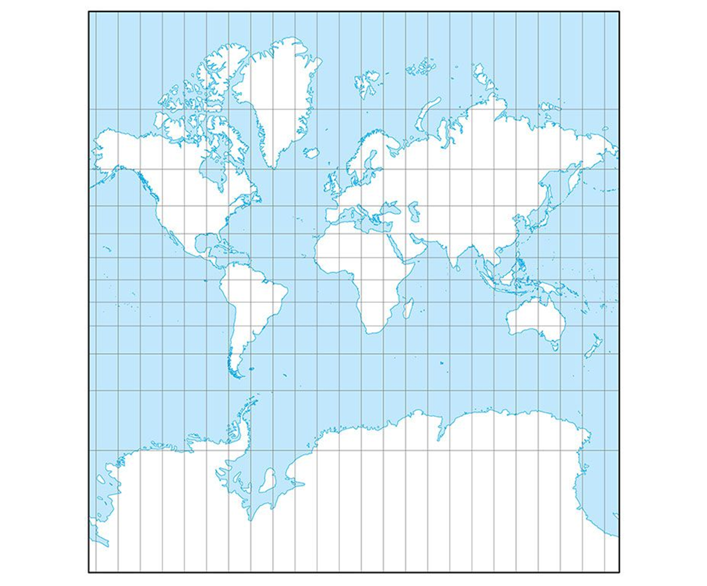
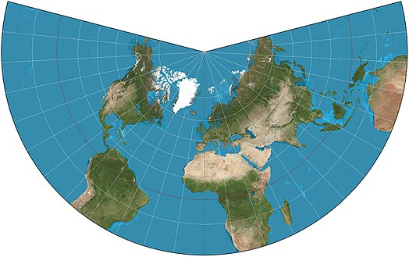
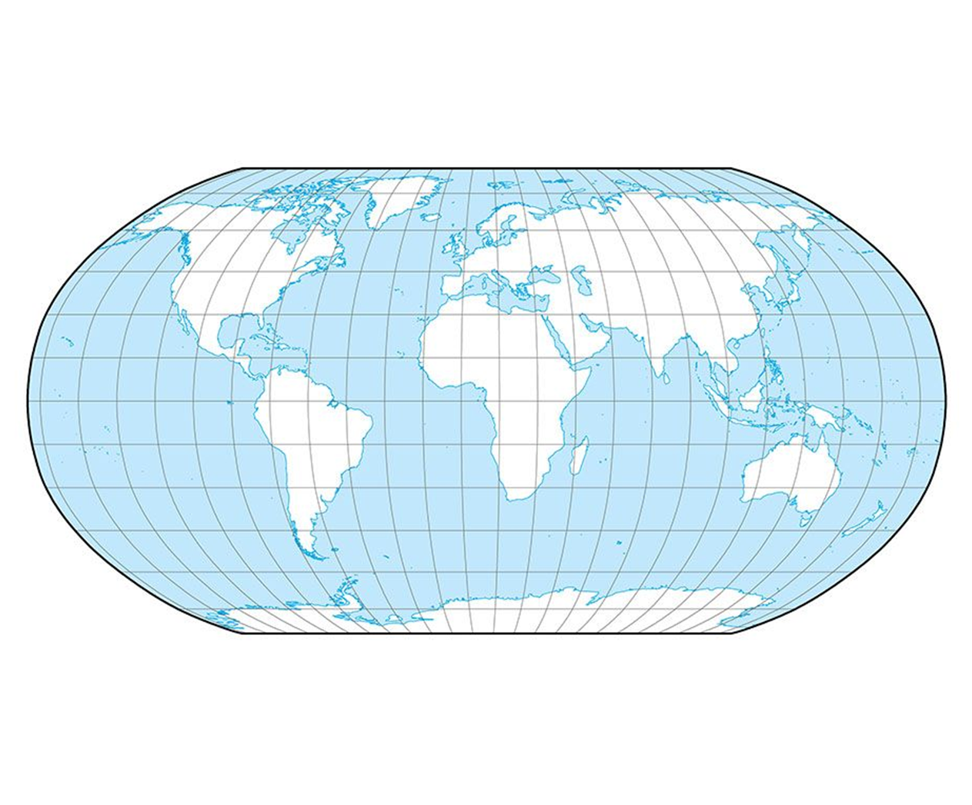
Projection | Purpose | Strengths | Distortion
 | Navigation | Directions are shown accurately Lines of latitude and longitude meet at right angles | Distance between lines of longitude appear constant Land masses near the poles appear large
 | Spatial Distributions Related to Area | Sizes of land masses are accurate | Shapes are inaccurate, especially near the poles
 | General Use in Midlatitude Countries | Lines of longitude converge Lines of latitude are curved Size and shape are both close to reality | Distance is not constant On a world map, longitude lines converge only at one pole
 | General Use | No major distortion Oval shape appears more like a globe than does a rectangle | Area, shape, size and direction are all slightly distorted
Notes:
Adapted from AMSCO Advanced Placement Human Geography, David Palmer 2019

Slide 13
Helpful links and activities on projection
https://www.nationalgeographic.org/activity/investigating-map-projections/
https://storymaps.arcgis.com/stories/ea0519db9c184d7e84387924c84b703f
See review pages 15-16 in the Study Session Study Guide

