Slide 1
RESEARCH METHODS
Unit 2
Notes:
Why are the answers that flow from the scientific approach more reliable than those based on intuition and common sense?
Our thinking, memory and attitudes operate on two levels: conscious and unconscious—larger operating part
Common misconceptions (stereotypes) about behavior that is persistent in in our pop culture:
-All blondes are dumb, Asians are smart, Elderly can’t drive, etc…

Slide 2
UNIT OVERVIEW
The need for Psychological Science
How do psychologists ask and answer questions?
Statistical reasoning in everyday life
Frequently asked questions about psychology
Notes:
Hindsight Bias and Judgmental Overconfidence illustrate why we cannot rely solely on intuition and common sense…need psychological research to provide definitive results based on experimentation and observation
Hindsight Bias: the tendency to believe, after learning an outcome, that one would have foreseen it (aka I knew it all along phenomenon)
Ex: Separation weakens romantic attraction (out of sight, out of mind) vs. Separation strengthens romantic attraction (absence makes the heart grow fonder). Both statements are easily imaginable/common sense. That leads to a problem because which theory is true?
Ex: Criminal profiling of certain ethnic or racial groups could be more efficient in making arrests, but can also lead to false accusations and missed opportunities

Slide 3
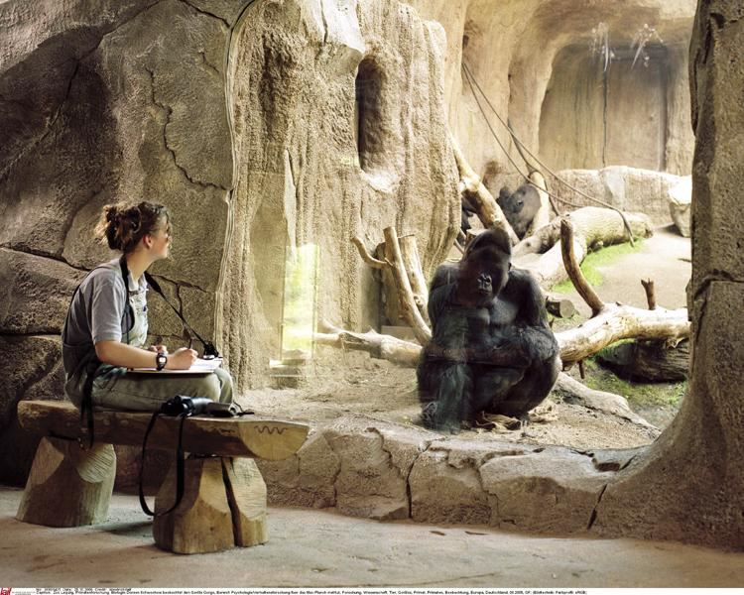
THE NEED FOR
PSYCHOLOGY SCIENCE

Slide 4
DID WE KNOW IT ALL ALONG? HINDSIGHT BIAS
Hindsight Bias
“I knew it all along”
“Out of sight, out of mind”
“absence makes the heart grow fonder”
Notes:
Tendency upon hearing about research findings (and many other things) to think that they knew it all along.
Hindsight Bias and Judgmental Overconfidence illustrate why we cannot rely solely on intuition and common sense…need psychological research to provide definitive results based on experimentation and observation
Hindsight Bias: the tendency to believe, after learning an outcome, that one would have foreseen it (aka I knew it all along phenomenon)
Ex: Separation weakens romantic attraction (out of sight, out of mind) vs. Separation strengthens romantic attraction (absence makes the heart grow fonder). Both statements are easily imaginable/common sense. That leads to a problem because which theory is true?
Ex: Criminal profiling of certain ethnic or racial groups could be more efficient in making arrests, but can also lead to false accusations and missed opportunities

Slide 5
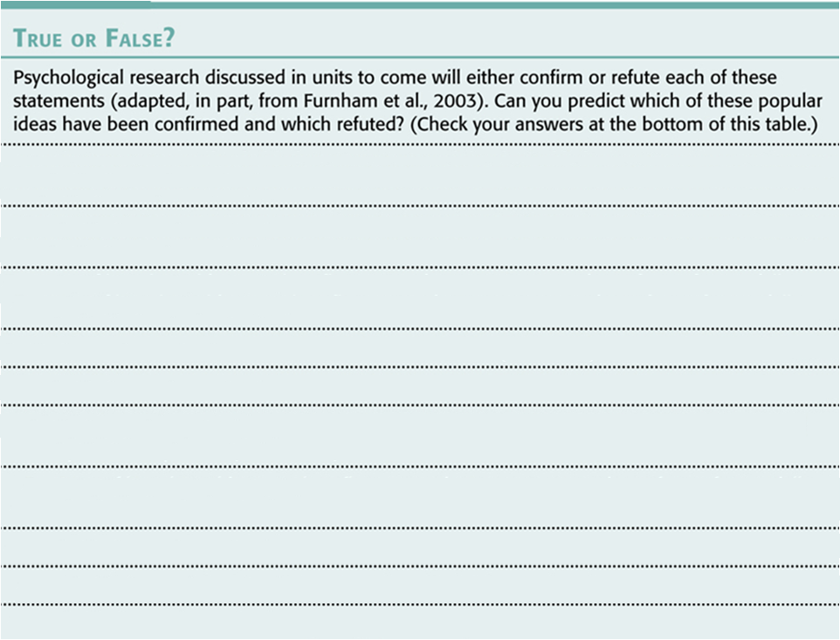

Slide 6
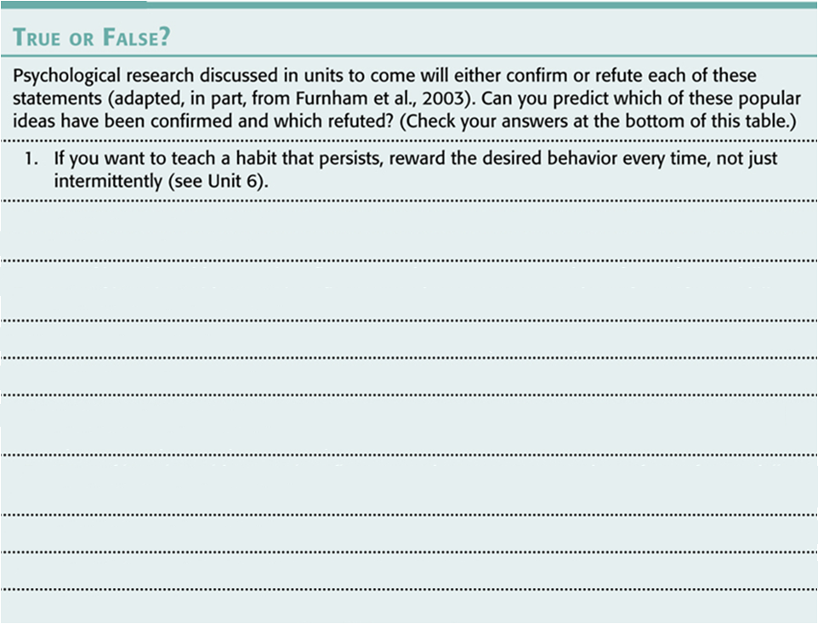

Slide 7
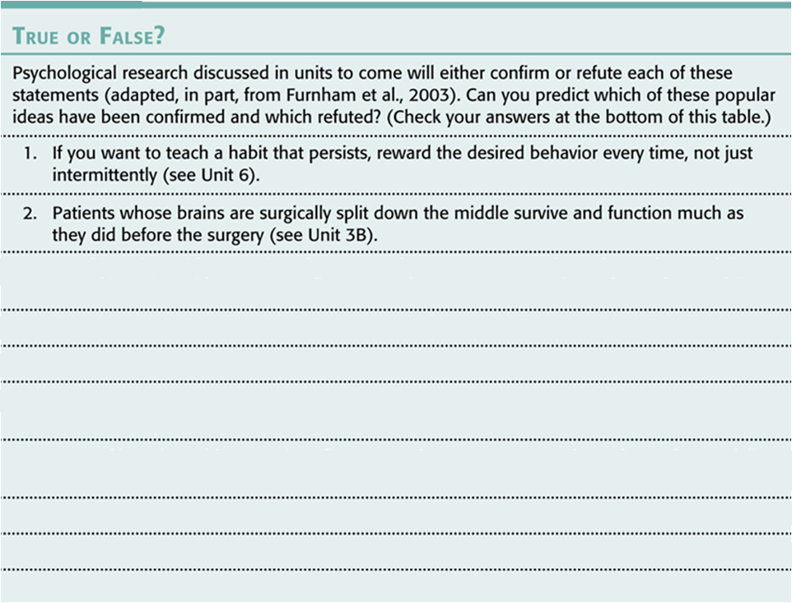

Slide 8
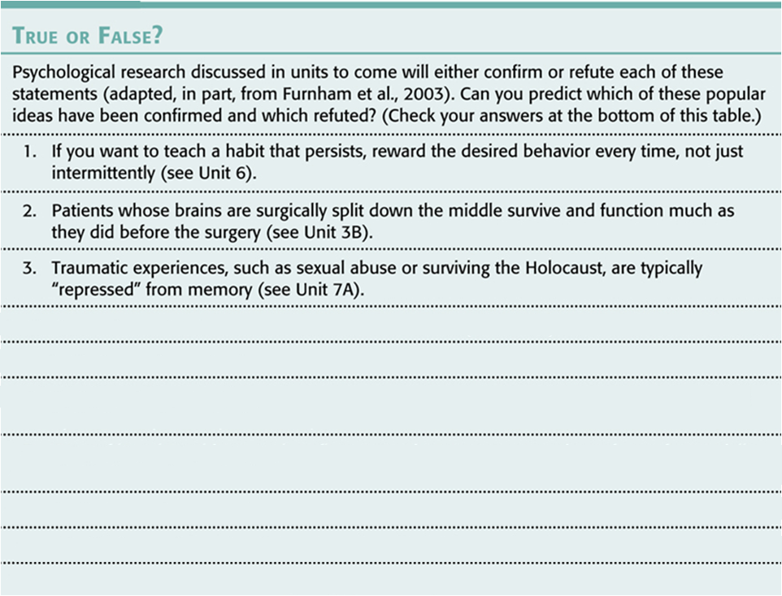

Slide 9
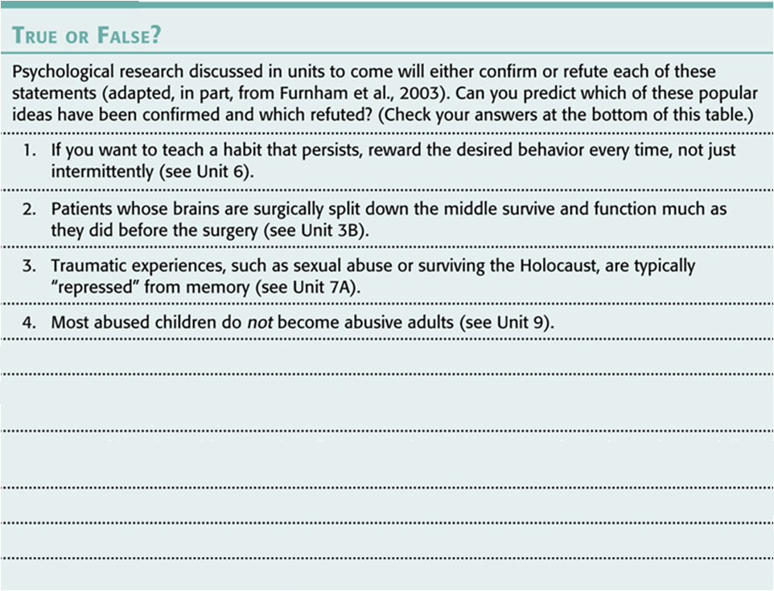

Slide 10
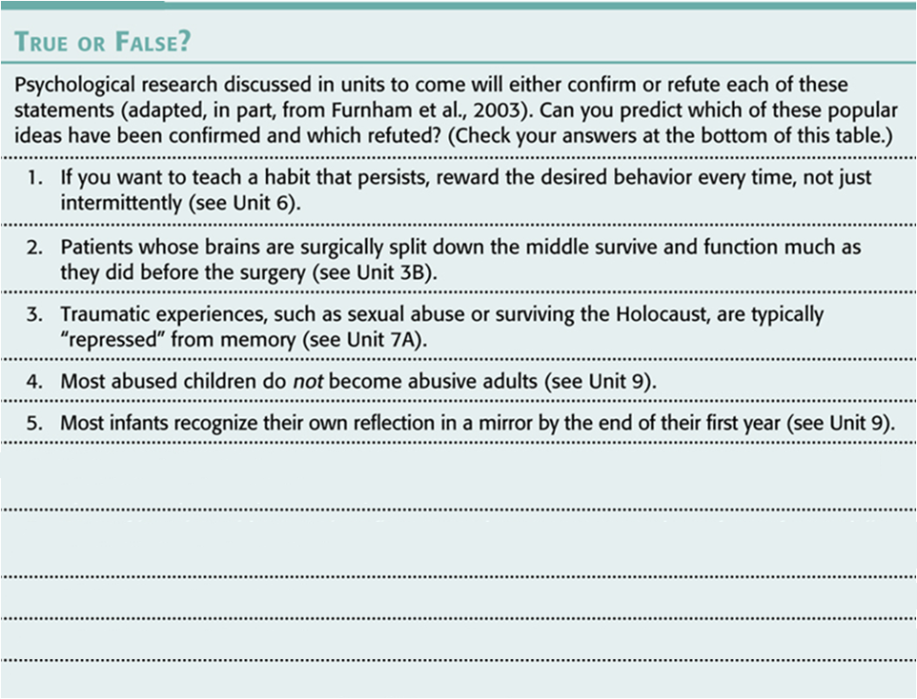

Slide 11
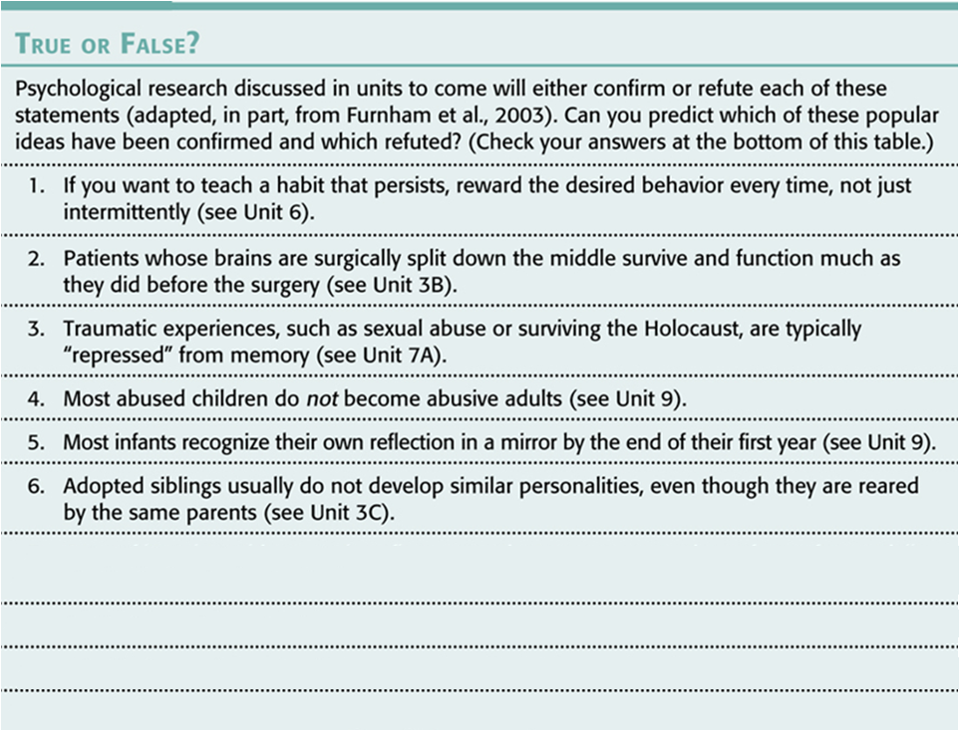

Slide 12
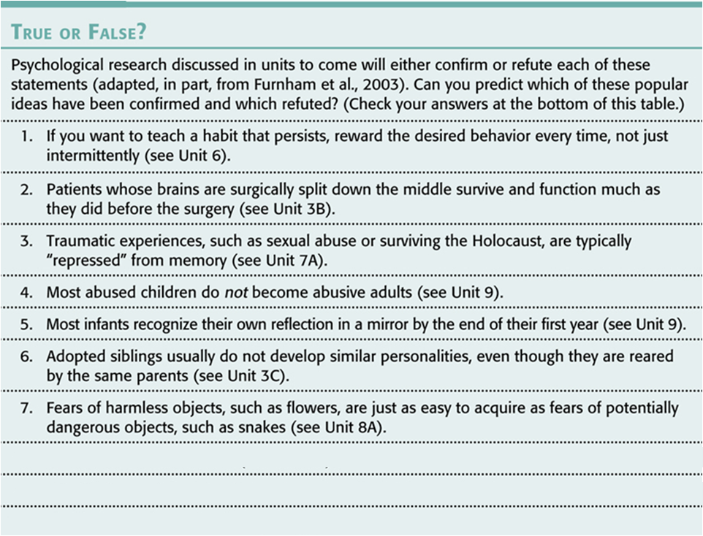

Slide 13
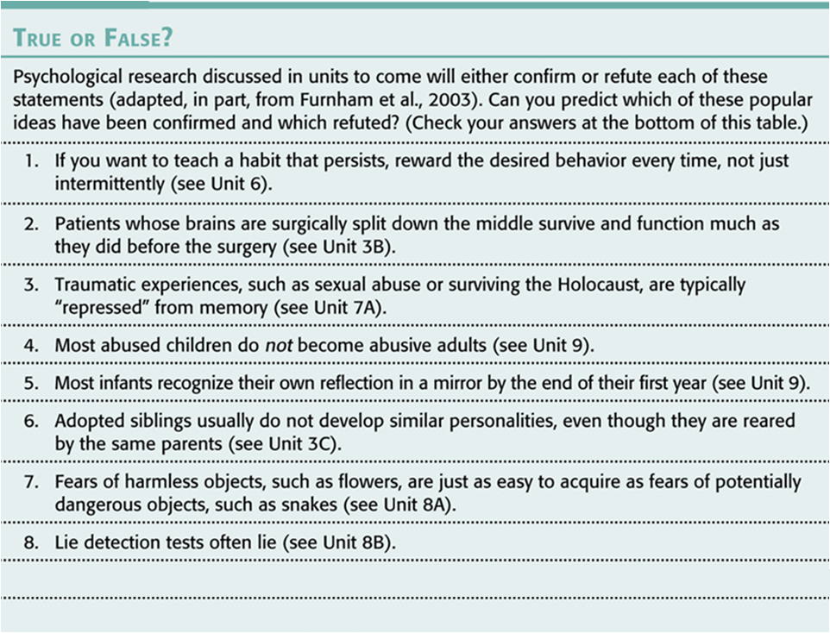

Slide 14
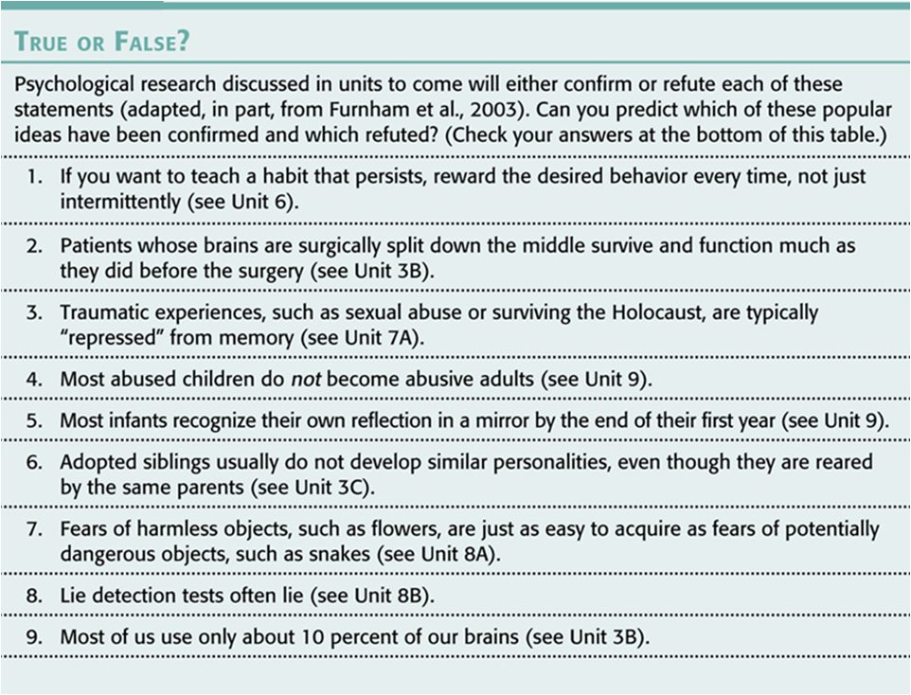

Slide 15
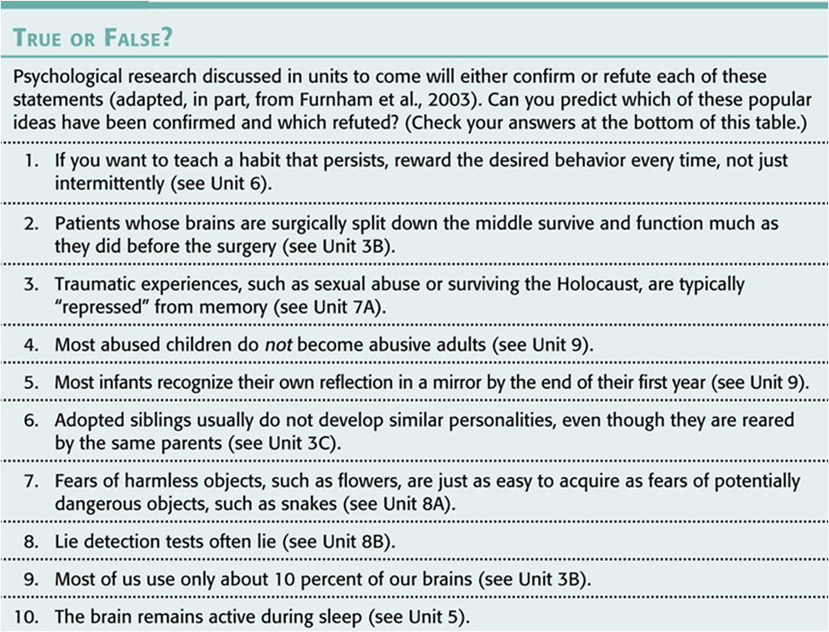

Slide 16
Notes:
1. F,
2. T
3. F
4.T
5. F
6. T
7. F
8. T
9. F
10. T

Slide 17
OVERCONFIDENCE
Overconfidence
Together with hindsight bias, can lead to overestimate our intuition
Notes:
Hindsight Bias and Judgmental Overconfidence illustrate why we cannot rely solely on intuition and common sense…need psychological research to provide definitive results based on experimentation and observation
Confirmation Bias (in unit 7B): A phenomenon in which people look for evidence that confirms their beliefs and ignore evidence that disputes their beliefs…leads to overconfidence
Overconfidence:
Once people know the answer to a question, hindsight makes the answer seem obvious—so much so that they become overconfident
**Hindsight bias and overconfidence often lead us to overestimate our intuition. But scientific inquiry can help us sift reality from illusion.

Slide 18
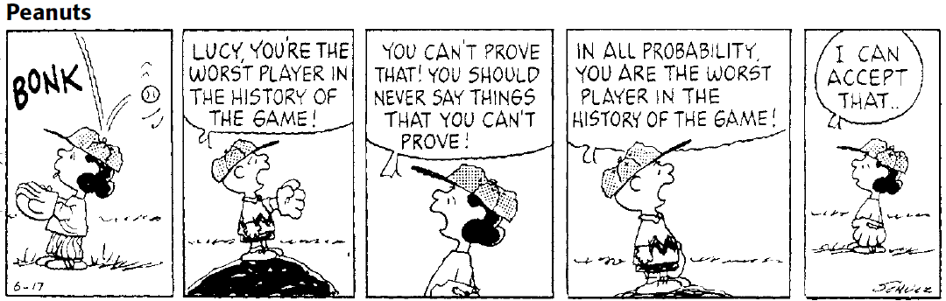
THE SCIENTIFIC ATTITUDE
Three main components
Curious eagerness
Skeptically scrutinize competing ideas
Open-minded humility before nature
Notes:
What are three main components of the scientific attitude?
Underlying all science is curiosity
Critical thinker’s question = Does the idea work? When put to the test, can its predictions be confirmed?
By letting the facts speak for themselves = empirical approach
Being skeptical, but not cynical; being open, but not gullible = scientific attitude
??s to ask as a scientific psychologists: What do you mean? How do you know?
**Scientific attitude = curiosity, skepticism, humility (an awareness of our own vulnerability to error and an openness to surprises and new perspectives)

Slide 19
CRITICAL THINKING
Critical thinking
“smart thinking”
Four elements
  Examines assumptions
  Discerns hidden values
  Evaluates evidence
  Assesses conclusions
http://www.youtube.com/watch?v=DTKGL59OkzI
The Amazing Randi
Notes:
Show “the Amazing Randi” James Randi clip on CNN with Anderson Cooper on debunking a variety of psychic phenomena (Sylvia Browne)
James Randi offers a $1 million prize for anyone who can demonstrate their “powers” in a scientifically controlled setting
No psychic has agreed to take a simple test to prove this.
Scientific attitude prepares us to think smarter = critical thinking (examines assumptions, discerns hidden values, evaluates evidence, and assesses conclusions)
Asks questions! And be open to surprising findings.
Critical thinking debunks popular presumptions
Example: Opposites do not generally attract

Slide 20
HOW DO PSYCHOLOGISTS ASK AND ANSWER QUESTIONS?

Slide 21
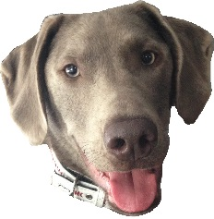
Approaches to Psych
Growth of Psych
Careers
The Science of Psychology
Ethics
Research Methods
We are here
Statistics
Sampling
Descriptive
Correlation
Experiment
Descriptive
Inferential
Case Study
Naturalistic Observation
Central Tendency
Variance
Survey

Slide 22
THE SCIENTIFIC METHOD
Theory
“mere hunch”
Hypothesis
Can be confirmed or refuted
Operational Definition
Replication (repeat)
Notes:
Operational definition: An explanation of how variables are measured
“Watching violent tv programs makes people aggressive”----Variables need to be operationally defined----What programs will be considered violent? What behaviors will be considered aggressive?
A self-correcting process for asking questions and observing nature’s answers.
Scientific method = Self-sustaining process;
Hypothesis leads to research which leads to theories which lead to more hypotheses.
The scientific process is a creative process because of the feedback loop. One researcher’s ideas can generate another researcher’s ideas, leading to a more thorough understanding of how the world works.

Slide 23
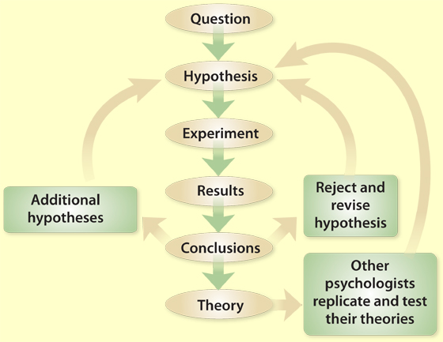
RESEARCH IN PSYCHOLOGY
The Scientific Method

Slide 24
START WITH OBSERVATIONS
Observe and describe the world with descriptive research
Form a hypothesis from your observations
Test your hypothesis.
Re-test your hypothesis
Then test it gain.
If it holds up you have a theory

Slide 25
THEORY
Theory is an EXPLANATION based on evidence that PREDICTS behaviors or events.
A Theory must:
1. Fit the known facts
2. Predict new discoveries
3. Be falsifiable
4. be simple. The simpler the better – Occam’s Razor
Notes:
25
If we were to observe that depressed people talk about their past, present, and future in a gloomy manner, we may theorize that low-self-esteem contributes to depression.

Slide 26
THE SCIENTIFIC METHOD
A good theory is useful if it:
  Effectively organizes a range of self-reports and observations
  Implies clear predictions that anyone can use to check the theory
Notes:
A good theory produces testable predictions: hypotheses

Slide 27
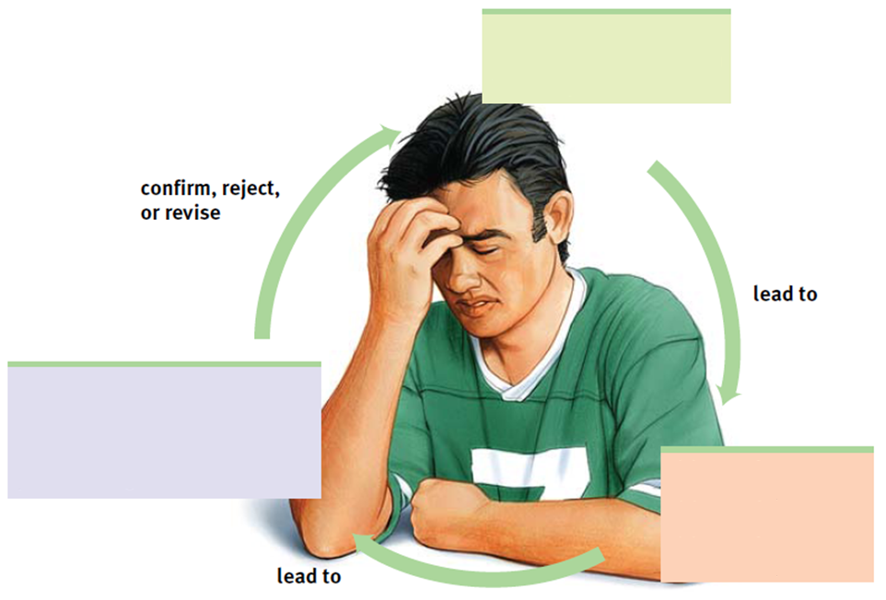
Notes:
.

Slide 28
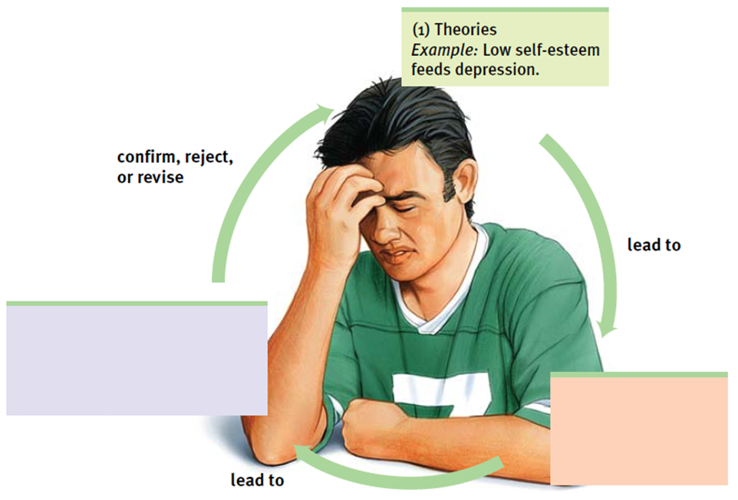
Notes:
How do theories advance psychological science?
Theory is linked to observation
A scientific theory explains through an integrated set of principles that organizes observations and predicts behaviors or events.
Theories are generally highly researched, rigorously tested frameworks that organize multiple studies under one umbrella of ideas. Not just educated guesses.
Good theories explain by:
1. Organizing and linking observed facts
2. Implying hypotheses that offer testable predictions and sometimes practical applications
Example: We observe over and over that people with depression describe their past, present and future in gloomy terms.
Theory = At the heart of depression lies low self-esteem

Slide 29
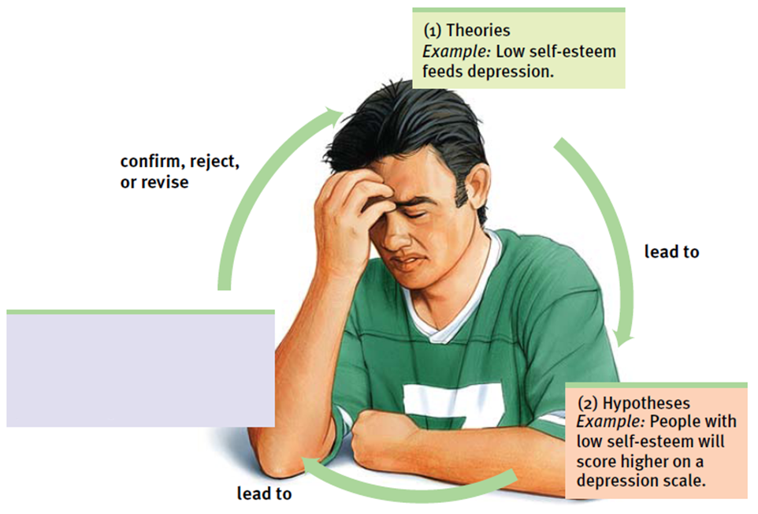
Notes:
A good theory produces testable predictions: hypotheses
By testing, rejecting or revising the originally theory about low self-esteem leads to depression, this allows for predications to give direction to research
In psychology, a hypothesis is a statement of relationship between or among variables. Psychologists generate these statements after researching what other scientists have learned and observing variables in the environment.
The psychological hypothesis may vary from a biological or physics hypotheses as an “educated guess”

Slide 30
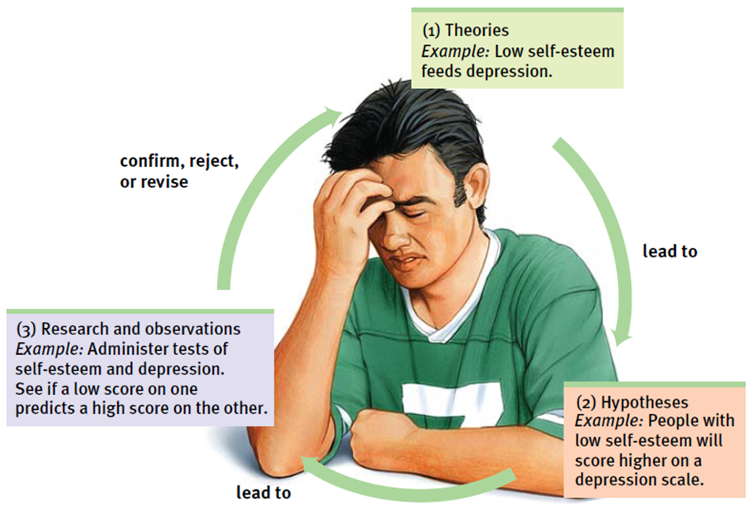
Notes:
Bias can form with subjective observations. To check on psychologists’ biases they can report their research with precise operational definitions of procedures & concepts to define research variables.
Important part of the research study because it defines what the researcher will be observing and manipulating.
Operational definitions need to be manageable and measurable. If not, the research will be difficult to conduct. Experiments are more likely to be replicated effectively if clear operational definitions are used.
Replication is the main goal of all good research. Replication allows researchers to test hypotheses with other samples from other populations so that results can be generalized or have generalizability (what degree the results of a study can be applied to different types of populations).
**We can test our hypotheses and refine our theories using descriptive research methods (case studies, surveys, or naturalistic observations), correlational research methods (which associate different factors), and experimental research methods (manipulate factors to discover their efforts)

Slide 31

Approaches to Psychology
Growth of Psychology
Careers
The Science of Psychology
Ethics
Research Methods
Statistics
Sampling
Descriptive
Correlation
Experiment
Descriptive
Inferential
Naturalistic Observation
We are here
Case Study
Central Tendency
Variance
Survey

Slide 32
DESCRIPTIVE RESEARCH
Purpose – To describe what is in reality
Strengths
  Certain descriptive research methods can be quick
  You can generalize (apply to more than just those from which you sampled) your findings with some descriptive research methods
Weaknesses
  Can’t help you predict
  Can’t give you cause and effect
  Each descriptive research method has their own weaknesses as well

Slide 33
3 TYPES OF DESCRIPTIVE RESEARCH
Naturalistic Observation
Survey
Case Studies

Slide 34
NATURALISTIC OBSERVATION
What is it? A descriptive research method involving the systematic study of animal or human behavior in natural settings rather than the laboratory
Huh? Researcher describes the behavior of the human or animal in their natural settings
Notes:
**Naturalistic Observation (records behavior in natural environments)
Examples: watching chimpanzees in the jungle, recording racial differences in students’ seating in the cafeteria, observing the pace of life in different cultures & climates
Does not explain behavior, it describes it.
Offers interesting snapshots of everyday life, but it does so without controlling for all the factors that may influence behavior (i.e. observe the pace of life In various places, but ignore what makes people walk faster than others in the culture)
Can provide data for correlational research, like surveys can

Slide 35
NATURALISTIC OBSERVATION
Strengths
  The behavior is more natural than if they were in the lab
Weaknesses
  Can not replicate. Replication involves the process of repeating a study using the same methods, different subjects, and different experimenters. If you can’t replicate you can’t retest the results or apply them to new situations to see just how generalizable it is.
  Can not generalize (apply them to new situations) your findings.
  Observer bias - occurs when the observers (or researcher team) know the goals of the study or the hypotheses and allow this knowledge to influence their observations during the study

Slide 36
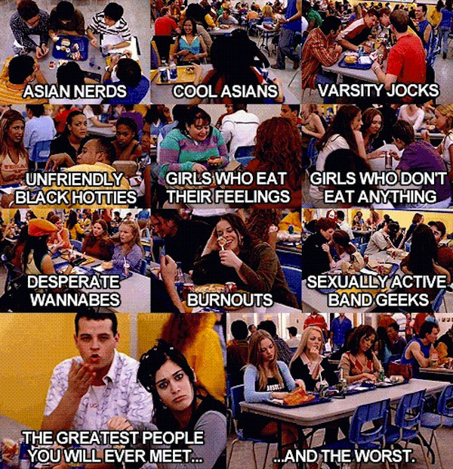
NATURALISTIC OBSERVATION

Slide 37
SURVEY
What is it? Descriptive research technique in which questionnaires or interviews are administered to a selected group of people.
Huh? To describe a large group of people you ask them carefully worded questions.
Notes:
Survey (looks at many cases in less depth)
Used when wanting to estimate, from a representative sample of people, the attitudes or reported behaviors of a whole population.
Asking questions are tricky, and the answers often depend on the ways questions are worded and respondents are chosen
Wording effects
Even subtle changes in the order or wording of questions can have major effects.
Ex: Should cigarette ads or pornography be allowed on television? People are much more likely to approve “no allowing” such things than “forbidding” or “censoring” them.
.

Slide 38
SURVEY
Strengths
  You can generate a lot of information for a fairly low cost
  Overcomes the false consensus effect
  If you randomly sampled then you can generalize your findings to the population from which you sampled.

Slide 39
SURVEY
Weaknesses
  Wording Effect
    Wording can change the results of a survey.
    Should cigarette ads be allowed on television?
    Should cigarette ads be censored on television?
  Social Desirability Effect
    If directly asked about a sensitive subject, we may alter our answer to what we think is socially acceptable.

Slide 40
“The root of the problem is that in real life, all scientists ever observe are samples. And, in real life, all they want to know about is populations” Nancy Darling, Ph.D.
Notes:
40

Slide 41
RANDOM SAMPLING
Sampling in which each potential population member has an equal chance of being surveyed.
Can’t just pull names from a hat
Alphabetical list and pick every 10th name.
Notes:
Random Sampling
Involves choosing at random participants from a larger population (for surveys, interviews, experiments, etc…) to generate a representative sample to generalize results with a smaller group of the public or larger group
Random sample = every person in the group has an equal chance of participating
Example: Drawing 5 names out of a hat to participate in an experiment or flipping a coin to see who will participate (heads = yes to participate; tails = no to participate)
Random assignment = Involves taking a randomly chosen sample and assigning the participants at random to either the experimental or control group of an experiment. Random assignment only applies to experiments

Slide 42
NON-RESPONSE BIAS
Women and Love study done by Shere Hite 1974
98% Dissatisfied by their Marriage
75% Extramarital Affairs
But to all of those who were mailed surveys only 4% responded.
Notes:
42

Slide 43
BUT…When randomly sampled
93% of women are satisfied in their marriages
Only 7% had affairs
Notes:
43

Slide 44


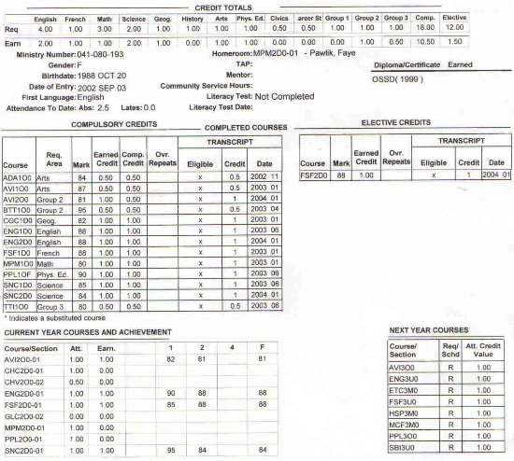
CASE STUDIES
What is it? Study of a single individual or just a few individuals in order to describe their situation.
Purpose? Take advantage of situation that you can not replicate (make happen again)
How? Gather as much evidence as you can: Observation, scores on psychological tests, interviews, medical records etc.
Notes:
How do psychologists observe and describe behavior?
Case study (examines one individual in depth in hopes of revealing things true of us all)
Suggest directions for further study and they show us what can happen.
Results can be misleading if the individual being studied is atypical/unique.
Examples: Studies of a few chimpanzees have revealed their capacity for understanding and language
Psychoanalysist: Freud, Carl Jung developed their theories of human personality based on case studies
Behavorists: John Watson and Rosalie Rayner conducted an intensive experiment known as the “Little Albert” study to demonstrate classical conditioned emotions. Little Albert was trained to fear white, furry objects by associating those objects with a loud noise.
Neuroscience: Paul Broca had a patient who could only utter one syllable: “tan” Upon Tan’s death, Broca studied the patient’s brain, hypothesizing that the damaged area was where our ability to speak lies.

Slide 45
CASE STUDIES
Strengths:
  Takes advantage of nonreplicable situations
  You get a lot of in-depth understanding
Weaknesses:
  Observer bias is a problem
  Can not generalize (apply your findings to other individuals or groups)
  Can not replicate
Notes:
45

Slide 46

Approaches to Psychology
Growth of Psychology
Careers
The Science of Psychology
Ethics
Research Methods
Statistics
Sampling
Descriptive
Correlation
Experiment
Descriptive
Inferential
Case Study
Naturalistic Observation
Central Tendency
We are here
Variance
Survey

Slide 47
CORRELATIOANAL RESEARCH
Purpose – to show relationship between two variables.
Strength – If you know how they are related you can predict outcomes.
Weakness – Correlation is not causation.

Slide 48
CORRELATIOANAL RESEARCH
Correlational Research
  Research technique based on the naturally occurring relationship between two or more variables
  Used to make PREDICTIONS, such as the relation between SAT scores and success at college
  Cannot be used to determine cause and effect
  Asks: Do the two variables vary together?
Notes:
48

Slide 49
START WITH TWO DEPENDENT VARIABLES
DV = Height
DV = Weight
DV = Golf Score
DV = Number of years the person has played golf
DV = IQ scores
DV = Size of your big toe
DV = Salary
DV = Happiness

Slide 50
DO THE VARIABLES VARY TOGETHER?
Are the numbers which represent height somehow related to (vary with) the numbers which represent weight?
Does a person’s golf score vary with years of practice?
Does IQ vary with big toe length?
Does happiness vary with salary?

Slide 51
CREATE OPERATIONAL DEFINITIONS
An exact description of how to derive a value for a characteristic you are measuring. It includes a precise definition of the characteristic and how, specifically, data collectors are to measure the characteristic.
It is a way to get a number from one of your variables.
Notes:
51

Slide 52
OPERATIONAL DEFINITIONS IN GREEN
DV = Height (in inches without shoes)
DV = Weight (in lbs without clothes)
DV = Golf Score (on golf course x)
DV = Number of years the person has played golf
DV = IQ scores (from the WAIS test)
DV = Size of your big toe (in mm from top of joint to top of toe)
DV = Salary (annual salary including bonuses and benefits)
DV = Happiness (???)

Slide 53
SCATTERPLOTS
Perfect positive
correlation (+1.00)
Scatterplot is a graph that comprises of points generated by values of two variables.
The slope of points depicts the direction,
The amount of scatter shows the strength of relationship.
Notes:
53

Slide 54
Correlation Coefficient (r=)
When one trait or behavior varies with another, we say the two correlate.
Indicates strength
of relationship
(0.00 to 1.00)
Correlation
coefficient
r =
+
0.37
Correlation Coefficient is a statistical measure of relationship between two variables.
Indicates direction
of relationship
(positive or negative)
Notes:
54
OBJECTIVE 8| Describe positive and negative correlations and explain how correlational measures can aid the process of prediction.

Slide 55
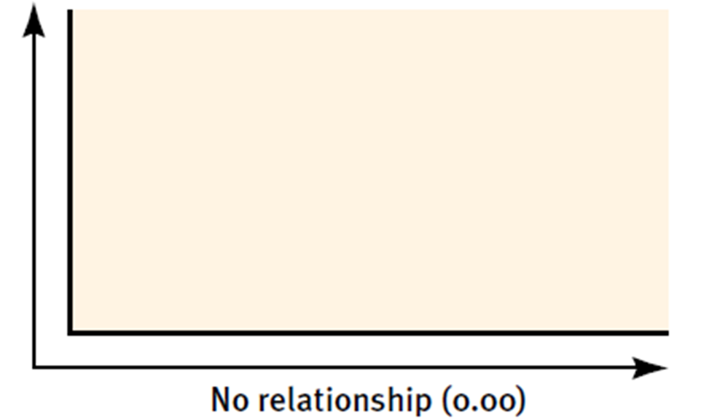
CORRELATION

Slide 56
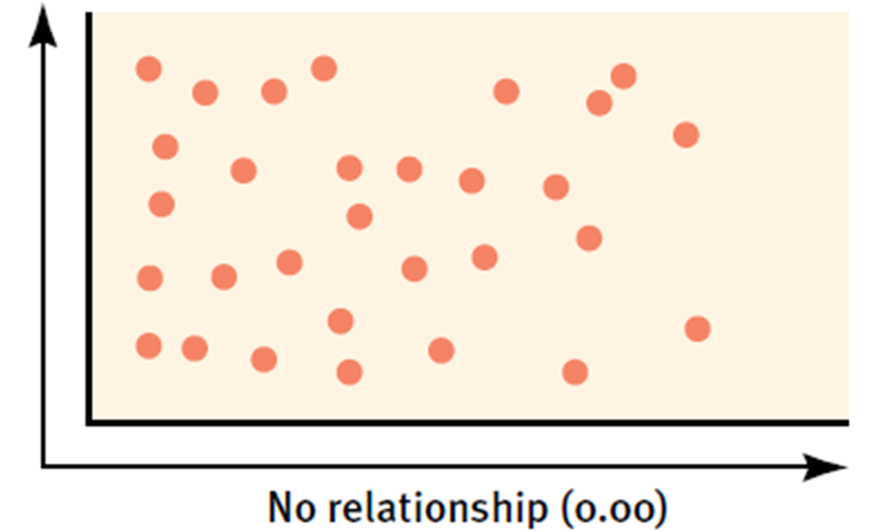
CORRELATION

Slide 57
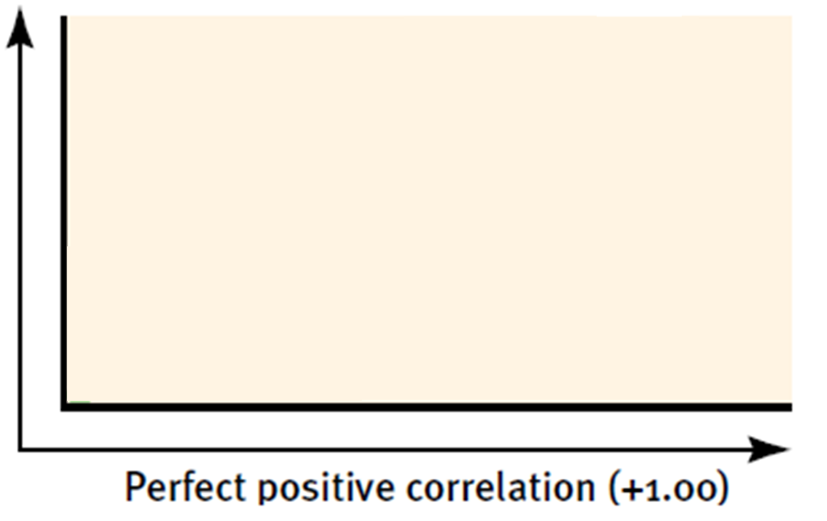
CORRELATION

Slide 58
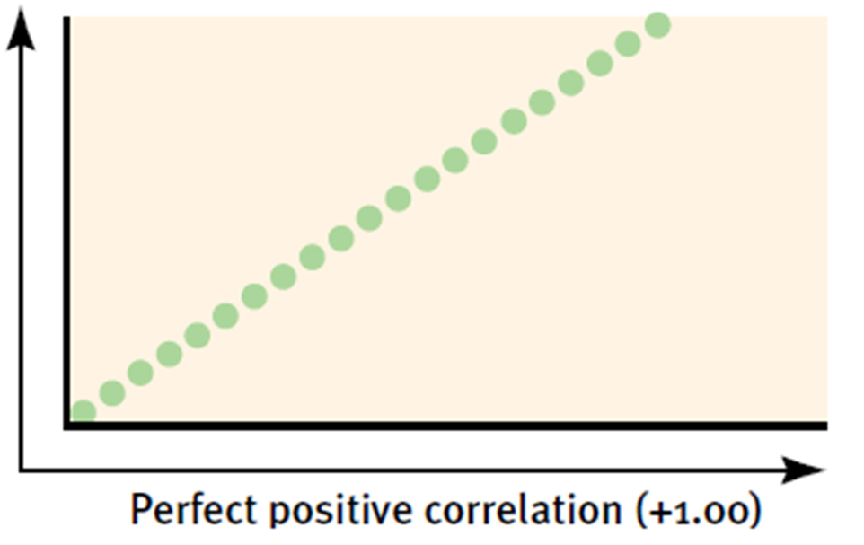
CORRELATION

Slide 59
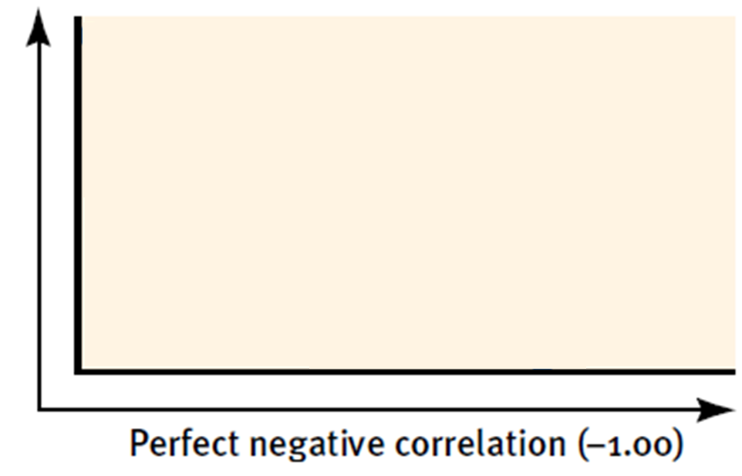
CORRELATION

Slide 60
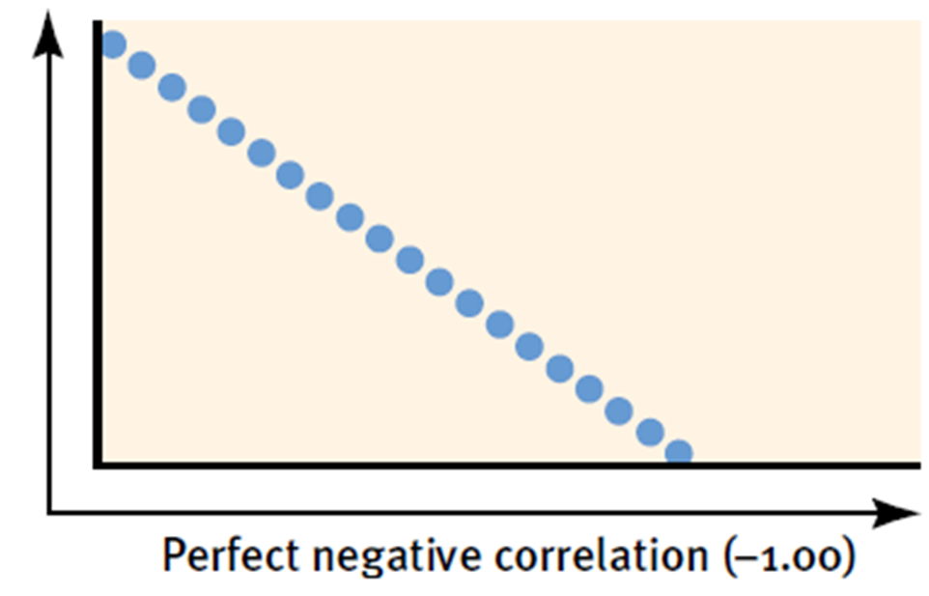
CORRELATION

Slide 61
POSITIVE OR NEGATIVE
The more young children watch TV, the less they read
The more sexual content teens see on TV, the more likely they are to have sex
The longer children are breast-fed, the greater their later academic achievement
The more adolescents eat breakfast, the lower their body mass
Notes:
-,+, +, -

Slide 62
CORRELATION: CORRELATION AND CAUSATION
Correlation helps predict
Does not imply cause and effect
Notes:
**The number of the correlation coefficient represents the strength of the correlation. The sign (+ or -) represents the direction of the correlation.
**Correlation does NOT prove CAUSATION!
Just because there is an association (correlation) it does not prove anything!
Correlation indicates the possibility of a cause-effect relationship, but it does not prove causation! Knowing two events are associated need not tell us anything about causation.
A third factor may be the cause of the correlation
Ex: Length of marriage correlates with hair loss in men. Does this mean that marriage causes men to lose their hair (or that balding men take better husbands)? In this case, as in many others, a third factor obviously explains the correlation: Golden anniversaries and baldness both accompany aging.

Slide 63
CORRELATIOANAL RESEARCH
Purpose – to show relationship between two variables.
Strength – If you know how they are related you can predict outcomes.
Weakness – Correlation is not causation.

Slide 64
Study of
Low Self Esteem and Depression
You do the research because you assume the two are related
Compare two variables
  Variable 1 = Score on a self-esteem test
  Variable 2 = Length of a bought of depression in months
Notes:
64

Slide 65
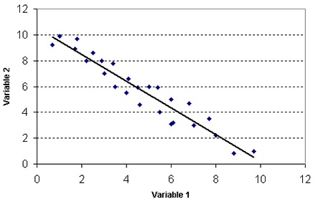
  Score on a self-esteem test
  Length of a bought of depression in months
Notes:
65

Slide 66
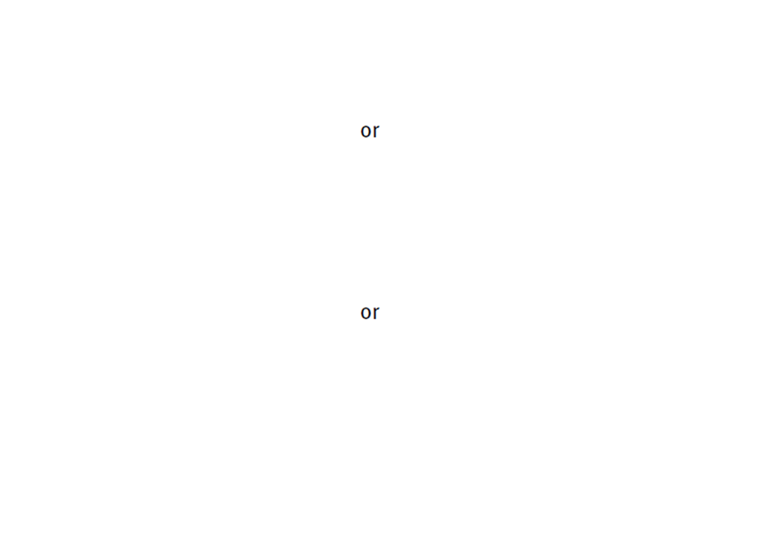

Slide 67
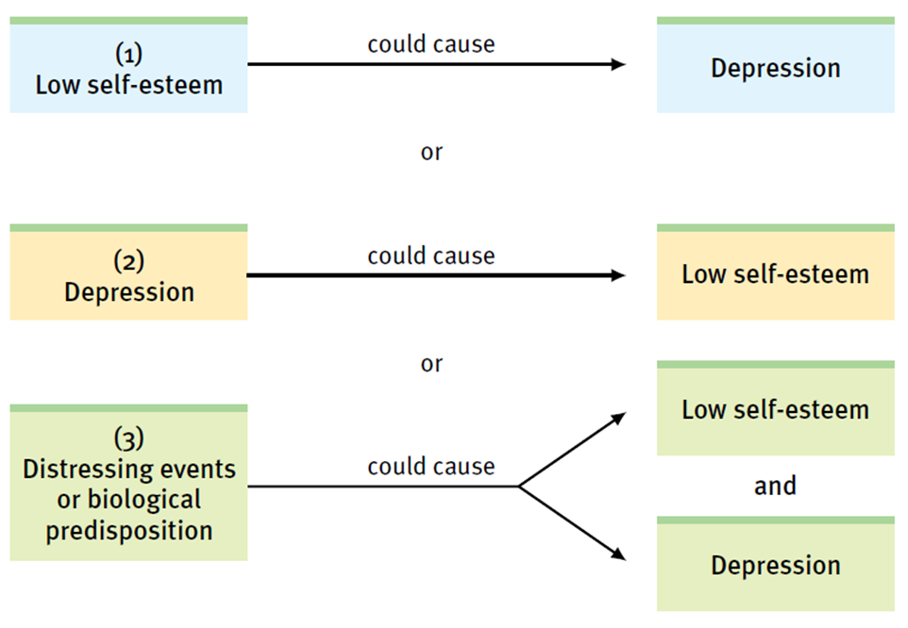

Slide 68
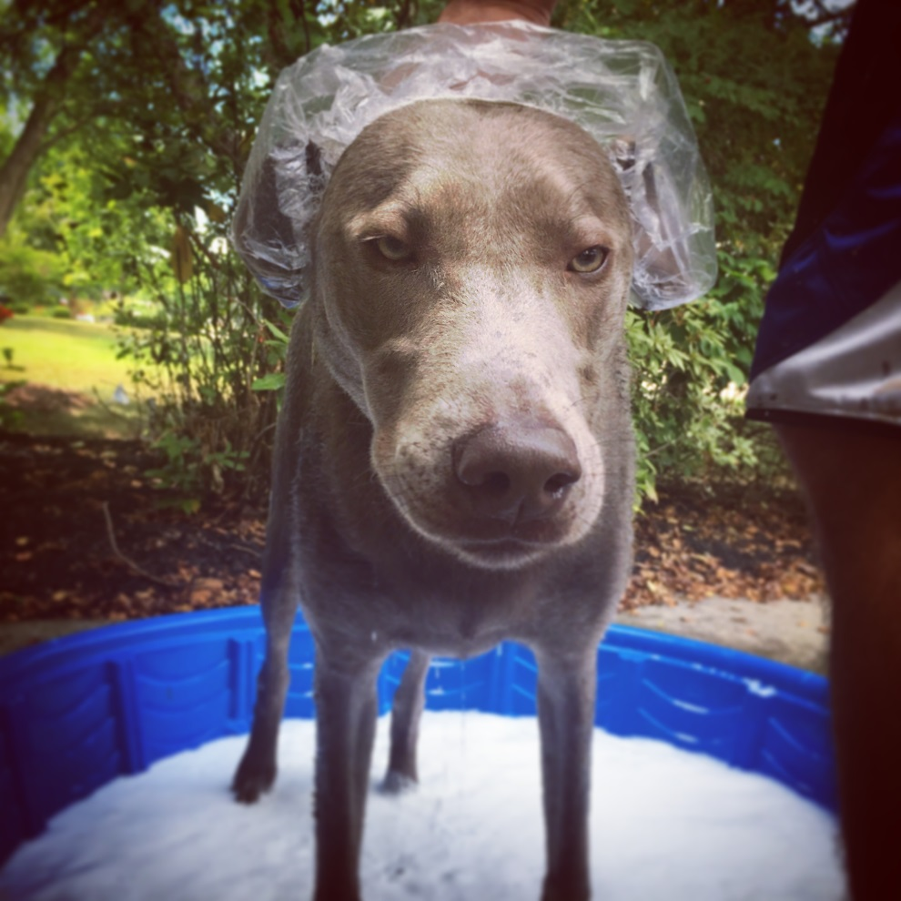
CORRELATION IS
NOT
CAUSATION!!!!

Slide 69

Correlation is not Causation:
It only predicts!!!!
Children with big feet reason better than children with small feet.
  (Children who are older have bigger feet than younger children; thus they can reason better)
Study done in Korea: The most predictive factor in the use of birth control use was the number of appliances in the home.
  (Those who have electrical appliances probably have higher socioeconomic level, and thus are probably better educated.)
Notes:
69

Slide 70
Correlation is not Causation:
It only predicts!!!!
People who often ate Frosted Flakes as children had half the cancer rate of those who never ate the cereal. Conversely, those who often ate oatmeal as children were four times more likely to develop cancer than those who did not.
  Cancer tends to be a disease of later life. Those who ate Frosted Flakes are younger. In fact, the cereal was not around until the 1950s (when older respondents were children, and so they are much more likely to have eaten oatmeal.)
Notes:
70

Slide 71
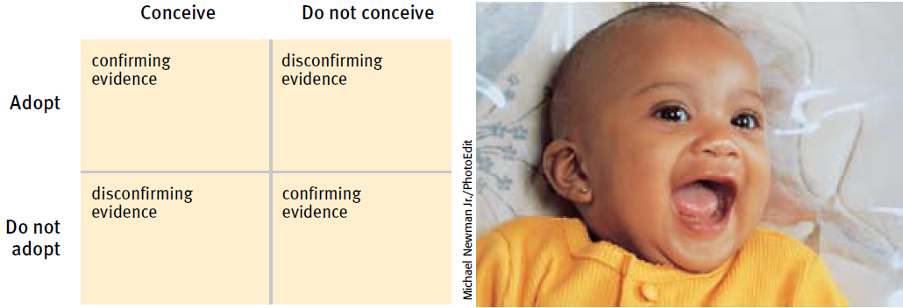
CORRELATION: ILLUSORY CORRELATIONS
Illusory correlation
Perceived non-existent correlation
A random coincidence
Notes:
What are illusory correlations?
A perceived but nonexistent correlation is an illusory correlation.
When we believe there is a relationship between two things, we are likely to notice and recall instances that confirm our belief.
Instead of making decisions based on all available evidence, we have a tendency to make judgments based on intuition or illusory correlations
We notice random coincidences and may forget there are random and instead see them as correlated
Illusory correlation help explain many superstitious beliefs, such as the presumption that infertile couples who adopt become more likely to conceive. Couples who conceive after adopting capture our attention and thus have more confirming evidence and research. We’re less likely to notice those who adopt and never conceive or those who conceive without adopting and thus have less evidence and research focused on the other factors.
Illusory correlation occurs when we over-rely on one factor and ignore equally essentially information in other factors.
Ex: Sugar makes children hyperactive, getting a chill and wet causes people to catch a cold, changes in the weather trigger arthritis pain

Slide 72
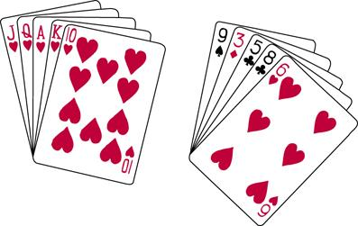
CORRELATION: PERCEIVING ORDER IN RANDOM EVENTS
Comes from our need to make sense of our world
Coin flip
Poker hand
Notes:
Perceiving Order in Random Events
Random sequences often don’t look random.
Ex: Flipping a coin six times will give you the same chance that you would flip head/tails ½ the time, all heads, or alternating heads/tails
A poker hand of 10 through ace (all hearts) would be no more or less likely than any other specific hand of cards
In actual random sequences, patterns and streaks (such as repeating digits) occur more often than people expect.
Basketball shooting, baseball hitting, mutual fund stock pickers’ selections
Statisticians Persi Diaconis and Frederick Mosteller, “with a large enough sample, any outrageous thing is likely to happen.” An event that happens to but 1 in 1 billion people every day occurs about six times a day, 2000 times a tear.

Slide 73
Approaches to Psych
Growth of Psych
Careers
The Science of Psychology
Ethics
Research Methods
Statistics
Sampling
Descriptive
Correlation
Experiment
Descriptive
Inferential
We are here
Case Study
Naturalistic Observation
Central Tendency
Variance
Survey

Slide 74
EXPERIMENTAL RESEARCH
Purpose – to establish cause and effect relationships between variables.
Strength – You find out if one variable (IV) causes a change in another variable (DV)
Weakness – Confounding variables, experimenter bias, etc.

Slide 75
EXPERIMENTATION
Experiment
Can isolate cause and effect
Control of factors
Manipulation of factor(s) of interest
Hold constant (“controlling”) factors
Notes:
Experimental Research (p. 34)
How do experiments, powered by random assignment, clarify cause and effect?
To isolate cause and effect, psychologists can statistically control other factors with experimentation
Experiments enable researchers to focus on the possible effects of one or more factors by:
1. Manipulating the factors of interest
2. Holding constant (“controlling”) other factors
**An experiment manipulates a factor to determine its effect unlike correlational studies which uncover naturally occurring relationships.
To find out if a remedy or theory is truly effective, we must experiment. This is the only type of study which can determine cause and effect.
Two main ways to group participants in a study:
1. Within-subjects design: involves comparing participants to themselves.
Ex: The researcher gives the participants a pre-test. All of the participants are exposed to the same independent variable and then takes a post-test. Participants serve as their own control group.
2. Between-subjects design: Comparing one group of participants to another. Most common experimental set up. Only one group in this design is exposed to the independent variable.
Can conduct the research in one sitting

Slide 76
CONTROL/EXPERIMENTAL GROUPS WHEN GIVING TREATMENTS
Examples of treatments:
  Drug trial
  School programs
  Food
The experimental group will get the treatment and the control group will not.

Slide 77
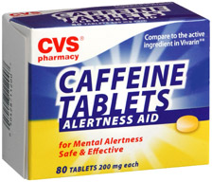
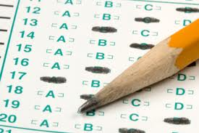
EXPERIMENTAL GROUP
In a controlled experiment, the group subjected to a change in the independent variable

Slide 78
PLACEBO EFFECT
It's what happens when a person takes a medication that he or she thinks will help, and therefore it actually does.
If you gave a 7 year old you were babysitting decaf but told them it was coffee they might convince themselves it was caffeinated and therefore act hyper.
Notes:
Just thinking the participants will get the treatment can boost their spirits, relax the body, and relieve their symptoms → placebo effect

Slide 79

It could be both . . .

Slide 80
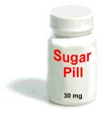
CONTROL GROUP
In a controlled experiment, this is the group NOT subjected to a change in the independent variable
The control group is the group that are given a placebo, nothing is changed
Notes:
By randomly assigning people to these conditions, researchers can be fairly certain the two groups are fairly identical.
Equalizes the group in age, attitudes and other characteristics
Helps to rule out the Hawthorne Effect
Being selected to be in a group of people to participate in an experiment will affect the performance of that group regardless of what is done to those individuals

Slide 81
RANDOM ASSIGNMENT OF PARTICIPANTS
This is when you randomly assign participants to either your control or experimental groups.
Get an alphabetical list of participants and assign every other name to the experimental group.
Random Assignment → Experiments
Random Selection → Surveys
Notes:
Random Assignments (assigning participants to experimental and control groups by chance) thus minimizing preexisting differences between those assigned to the different groups.
**Different from random sampling in surveys in that random sampling helps us generalize to a larger population while random assignments controls unnecessary influences, which helps us infer cause and effect.

Slide 82
SINGLE/DOUBLE BLIND PROCEDURE
Single Blind:
      During an experiment only the participant is unaware of the group they are in, either the control or experimental group
Double Blind:
      - During an experiment both the participant and the researcher in the room are unaware of the group they are in.

Slide 83
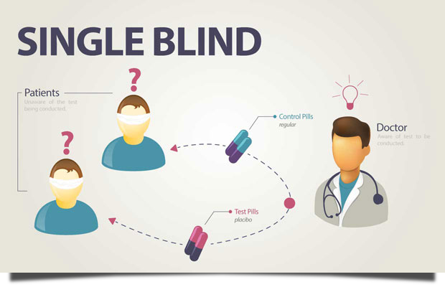
Placebo
Drug

Slide 84
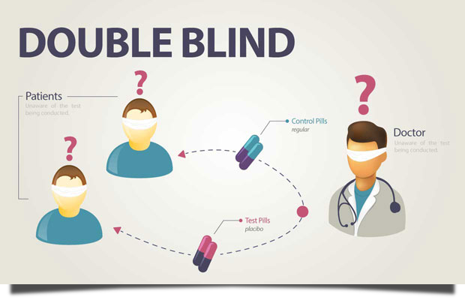
Placebo
Drug

Slide 85
CONFOUNDING VARIABLES
Variables that a researcher fails to control for or eliminate.
The only thing that should change is the Independent Variable. If the IV is the only thing that changes, then it must be the thing that caused the change.
If there were confounding variables it might have been them as well.
Notes:
The other factors, which can potentially influence the results of the experiment = confounding variables
Random assignment controls for possible confounding variables

Slide 86
EXPERIMENTER BIAS
Errors in a research study due to the predisposed notions or beliefs of the experimenter.
Or in other words, the point in every research paper you’ve ever written when you purposely ignore a source that directly contradicts your thesis.

Slide 87

INDEPENDENT/DEPENDENT VARIABLE
Independent Variable
  Cause (what you are studying)
  This is the variable that is manipulated by the experimenter
  The variable that I change
Dependent Variable
  Effect (result of experiment)
  This is the variable that is measured by the experimenter
  It DEPENDS on the independent variable
Cause
Effect
Independent Variable
Dependent Variable

Slide 88
IV and DV in a real study
"There will be a statistically significant difference in graduation rates of at-risk high-school seniors who participate in an intensive study program as opposed to at-risk high-school seniors who do not participate in the intensive study program." (LaFountain & Bartos, 2002, p. 57)
IV: Participation in intensive study program.
DV: Graduation rates.

Slide 89
Help with IV vs. DV
A good way to determine the IV from the DV is to word the Hypothesis in the form of an “If . . . then . . .” statement.
What follows the IF is the IV
What follows the THEN is the DV
Notes:
89

Slide 90
CREATE OPERATIONAL DEFINITIONS
An exact description of how to derive a value for a variable you are measuring. It includes a precise definition of the variable and how, specifically, data collectors are to measure the characteristic.
This lets you replicate your study as well.
It is a way to get a number from one of your variables.
Notes:
90

Slide 91


VARIABLES
Hypothesis: an educated guess
Variables: factors that are measured or controlled in a scientific study
Independent variable: factor that researchers manipulate so that they can determine its effect (IF)
Dependent variable: depends on the independent variable. It is the result of change in the independent variable (THEN)
WARM TEMPERATURE CAUSES AGGRESSION IN HUMANS
=

Slide 92
EXPERIMENTAL RESEARCH
Manipulation of an independent variable under carefully controlled conditions to see whether any changes occur in the dependent variable
Harlow’s monkey
  http://www.youtube.com/watch?v=_O60TYAIgC4

Slide 93
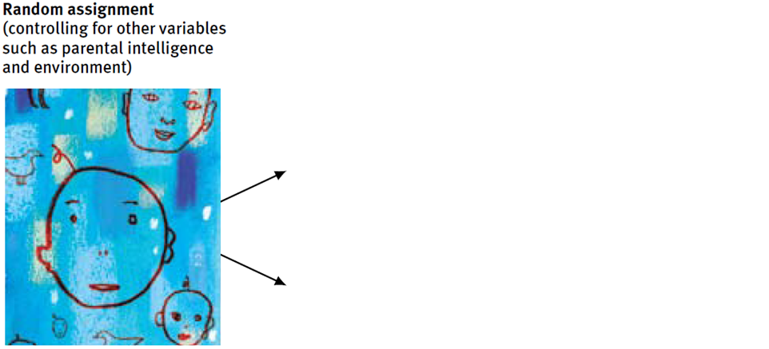
EXPERIMENTAL DESIGN
Notes:
In summary…
Experiments aim to manipulate an independent variable, measure the dependent variable, and control confounding variables.

Slide 94
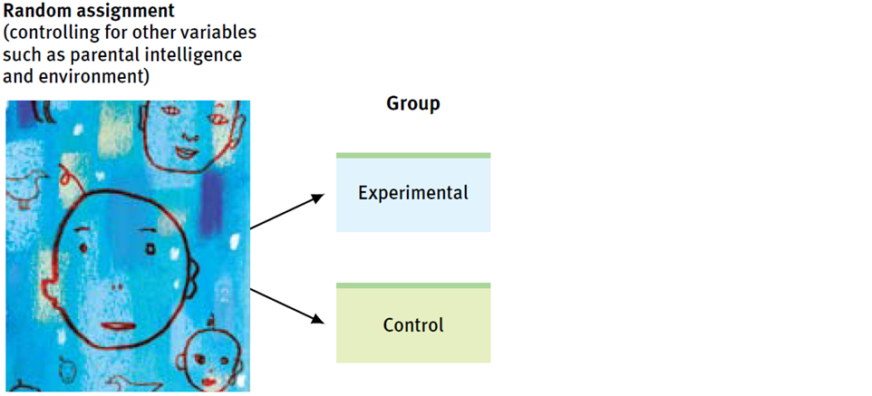
EXPERIMENTAL DESIGN
Notes:
Experiments have two different groups: experimental and control/comparison

Slide 95
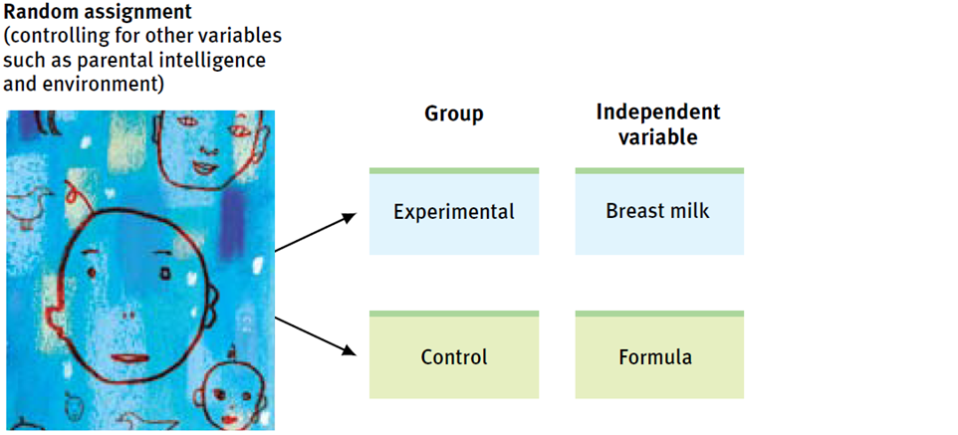
EXPERIMENTAL DESIGN
Notes:
Random assignment works to equate the groups before any treatment effects.

Slide 96
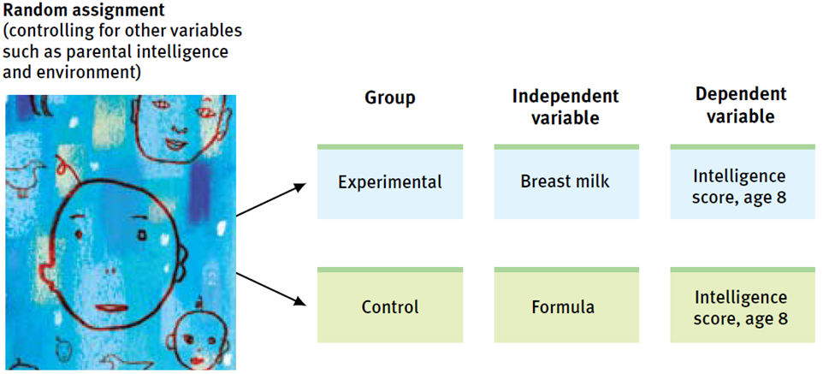
EXPERIMENTAL DESIGN

Slide 97
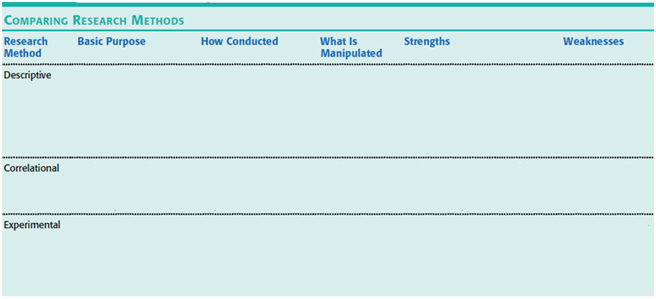
COMPARING RESEARCH METHODS

Slide 98
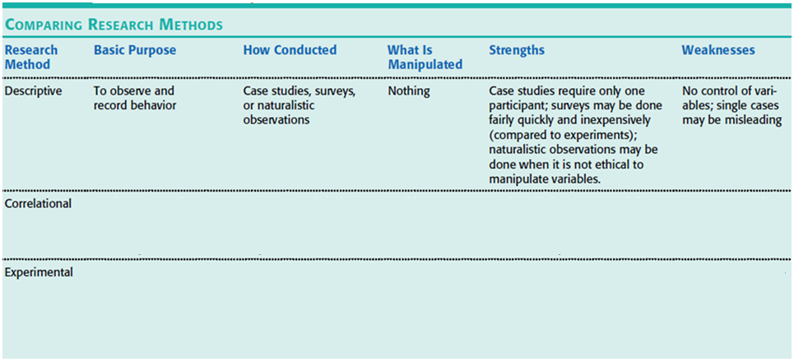
COMPARING RESEARCH METHODS

Slide 99
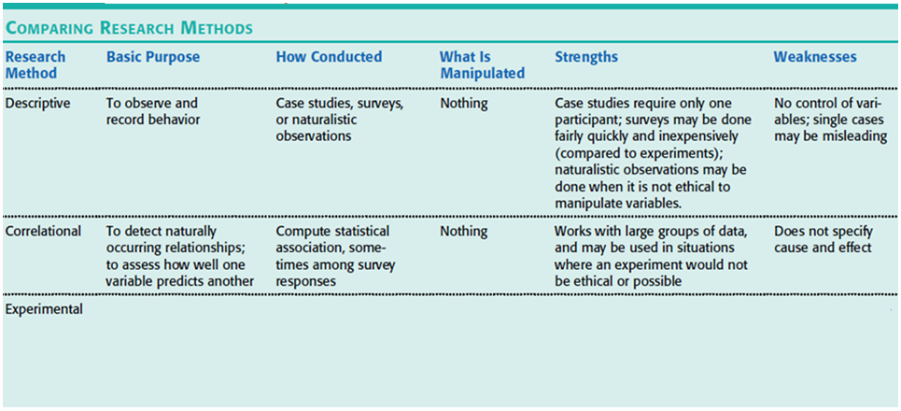
COMPARING RESEARCH METHODS

Slide 100
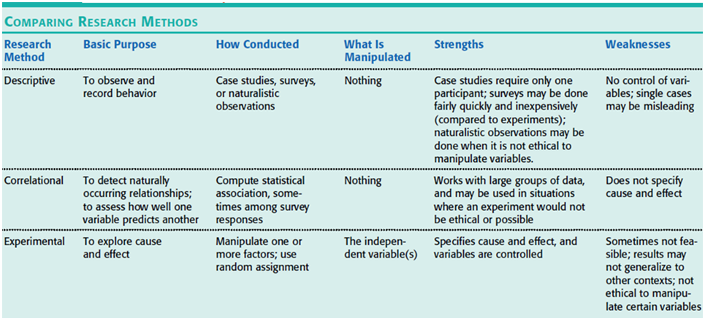
COMPARING RESEARCH METHODS
Notes:
Overall goals of the different research methods:
Case studies and naturalistic observations only describe behavior.
Correlations can be used to predict future phenomena
Experiments determine cause and effect.

Slide 101
STATISTICAL REASONING
IN EVERYDAY LIFE
Notes:
STATISTICAL REASONING IN EVERYDAY LIFE (p. 37)
Doubt, big, round, undocumented numbers.
Focus on thinking smarter by applying simple statistical principles to everyday reasoning.
How can we describe data with measures of central tendency and variation?
Step 1: When viewing figures in magazines and on television, read the scale labels and note their range
Step 2: Summarize the data using some measure of central tendency (a single score that represents a whole set of scores)—measures the center of a set of data

Slide 102
Approaches to Psych
Growth of Psych
Careers
The Science of Psychology
Ethics
Research Methods
Statistics
Sampling
Descriptive
Correlation
Experiment
Descriptive
Inferential
We are here
Case Study
Naturalistic Observation
Central Tendency
Variance
Survey

Slide 103
CENTRAL TENDENCY
Tendency of scores to congregate around some middle variable
A measure of central tendency identifies what is average or typical in a data set
Notes:
103

Slide 104
MEASURES OF CENTRAL TENDENCY
Mode: The most frequently occurring score in a distribution.
Mean: The arithmetic average of scores in a distribution obtained by adding the scores and then dividing by their number.
Median: The middle score in a rank-ordered distribution.
Notes:
104
OBJECTIVE 17| Describe three measures of central tendency and tell which is most affected by extreme scores.

Slide 105
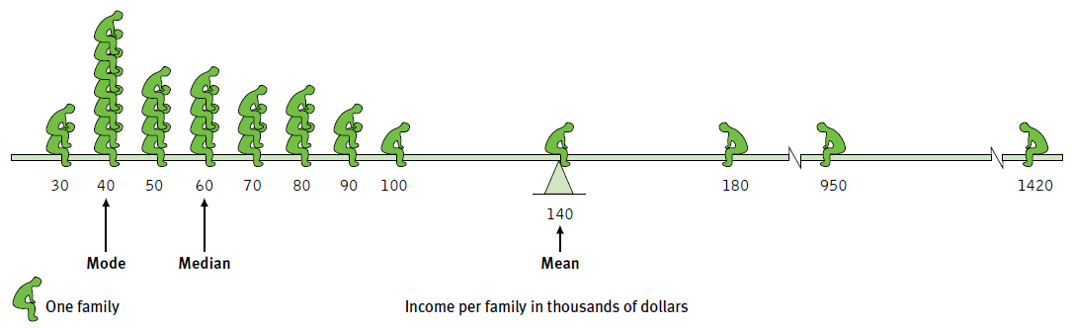
DESCRIBING DATA (DESCRIPTIVE STATS): MEASURES OF CENTRAL TENDENCY
Mode (occurs the most)
Mean (arithmetic average)
Median (middle score)
Notes:
Simplest measure in a distribution = mode (the most frequently occurring score or scores)
The most commonly reported is the mean (or arithmetic average)
The median is the midpoint—the 50th percentile
**Always note which measure of central tendency is reported. If it is a mean—consider whether a few atypical scores could be distorting or skewing the data.
Positive skew occurs when scores pull the mean toward the higher end of the scores (the mean is “more positive” than the rest of the scores)
Negative skew occurs when the mean is being pulled down toward the lower end of the scores.

Slide 106
MEASURES OF VARIATION
Measures of Variation
Statistical dispersion (how distributed the data points are) is a key concept in statistics.
Two key ways of measuring statistical dispersion
  Range
  Standard Deviation
Notes:
106
Measures of Variation
Central tendency (the center of the data) tells us the amount of variation in the data (how similar or diverse the score are)
Averages derived from scores with low variability are more reliable than averages based on scores with high variability
Ex: Bball player scores between 13-17 points in her first 10 games. Knowing this we would be more confident to estimate she would score 15 points in her next game than if her points varied from 5-25
The range of scores (the gap between the lowest and highest scores in a distribution) provides only a rough estimate of variation
Standard deviation is a computed measure of how much scores vary around the mean score and how different the scores are from each other. (more informative than mean alone)
The higher the standard deviation, the less similar the scores are.
Ex: If a set of test scores has a standard deviation of 5, then everyone who took the test score similarly. If the scores have a standard deviation of 50, then the test takers’ scores were not very similar at all.

Slide 107
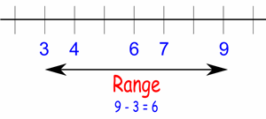
RANGE
The range simply gives the lowest and highest values of a data set.
Notes:
107

Slide 108
STANDARD DEVIATION
Standard deviation gives a measure of dispersion.
Essentially, they are measures of the average difference between the values.
Standard deviation gives a value that is directly comparable to your mean values.
Notes:
108
Standard deviation is a computed measure of how much scores vary around the mean score and how different the scores are from each other. (more informative than mean alone)
The higher the standard deviation, the less similar the scores are.
Ex: If a set of test scores has a standard deviation of 5, then everyone who took the test score similarly. If the scores have a standard deviation of 50, then the test takers’ scores were not very similar at all.

Slide 109
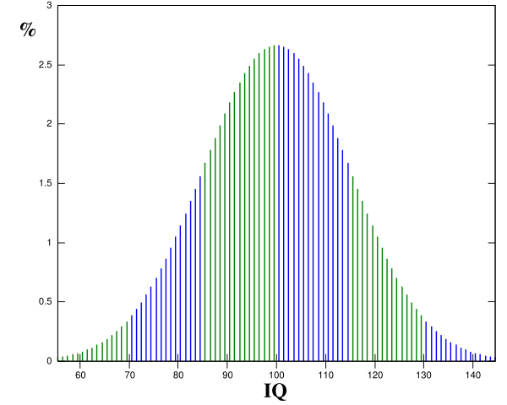
Standard Deviation in Action
A couple needs to be within one standard deviation of each other in intelligence (10 points in either direction). —Neil Clark Warren, founder of eHarmony.com
Notes:
109

Slide 110
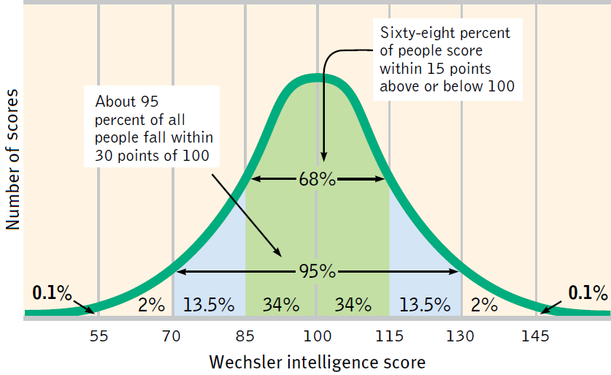
DESCRIBING DATA: MEASURES OF VARIABILITY
Normal Curve (bell shaped)
Notes:
Normal Curve: A symmetrical, bell-shaped curve that describes the distribution of many types of data; most scores fall near the mean and fewer and fewer near the extremes.

Slide 111
MAKING INFERENCES: WHEN IS AN OBSERVED DIFFERENCE RELIABLE?
Representative samples are better than biased samples
Less-variable observations are more reliable than those that are more variable
More cases are better than fewer
Inferential statistics
Statistics that can determine whether or not findings can be applied to the larger population from which the sample was selected
Notes:
Making Inferences
What principles can guide our making generalizations from samples and deciding whether differences are significant?
Reliability?
In deciding when it is safe to generalize from a sample, we should keep three principles in mind:
Representative samples are better than biased samples.
Not the exceptional, memorable cases but from a representative sample of cases
2. Less-variable observations are more reliable than those that are more variable.
An average is more reliable when it comes from scores with low variability
3. More cases are better than fewer.
Averages based on many cases are more reliable (less variable) than averages based on only a few cases.
**Generalizations based on a few unrepresentative cases are unreliable.

Slide 112
INFERENTIAL STATISTICS
You are trying to reach conclusions that extend beyond just describing the data.
These are used to test hypothesis about samples.

Slide 113
MAKING INFERENCES: WHEN IS A DIFFERENCE SIGNIFICANT?
Statistical significance
The averages are reliable
The differences between averages is relatively large
Does imply the importance of the results
Notes:
When is a difference significant?
When averages from two samples are each reliable measures of their respective populations, then their difference is likely to be reliable as well.
When the difference between the sample averages is large, we have even more confidence that the difference between them reflects a real difference in their populations.
When the sample averages are reliable, and when the differences between them is relatively large = difference has statistical significance = the observed difference is probably not due to chance variation between the samples.
**Statistical significance indicates the likelihood that a result will happen by chance. This does not say anything about the importance of the result.
Statistical significance refers to how two groups’ means are different by chance.
The usual goal is to get a significance level of .05, which says that the results are only 5 percent due to chance (or 95% due to your independent variable)
**Effect size is the new way from researchers to report their results. Effect size is the measure of the strength of a relationship between variables). Effect size tells more about the quality of the data collected than significance can alone.

Slide 114
RELIABILITY VS VALIDITY: GOOD RESEARCH IS BOTH
Reliability
when replicated
when consistent
If the researcher conducted the same research in the same way, the researcher would get similar results
Validity
Measures what the researcher set out to measure; it is accurate

Slide 115
FREQUENTLY ASKED QUESTIONS ABOUT PSYCHOLOGY

Slide 116
PSYCHOLOGY APPLIED
Can laboratory experiments illuminate everyday life?
The resulting principles, not the research findings, help explain behavior

Slide 117
PSYCHOLOGY APPLIED
Does behavior depend on one’s culture and gender?
Culture
  Influence of culture on behavior
Gender
  More similarities than differences

Slide 118

ETHICS IN RESEARCH
Ethics in animal research
  Clear scientific purpose
  Care for and house animals in a humane way
  Acquire animal subjects legally
  Design experimental procedures that employ the least amount of suffering feasible
Notes:
Ethics in Research
ANIMAL RESEARCH
Psychologists study animals to learn about people, by doing experiments permissible only with animals
Humans are not like animals; we are animals.
Animal experiences have therefore led to treatments for human diseases—insulin for diabetes, vaccines to prevent polio, transplants to replace defective organs
In U.S. & Canada 60% of adults deem medical testing on animals “morally acceptable”; in Britain only 37% do.
Controversy:
Is it right to place the well-being of humans above that of animals?
Many agree that it is sometimes permissible to sacrifice animals for human well-being
We value animals according to their perceived kinship with human (primates/dogs/cats get top priority)
2. What safeguards should protect animals?
98% support government regulations protecting primates, dogs and cats
74% support regulations providing for the humane care of rats & mice
APA guidelines (2002) mandate ensuring the “comfort, health and humane treatment” of animals and of minimizing the “infection, illness and pain of animal subjects”
**Stanley Milgram’s obedience study forced researchers to consider the long-term psychological effects on participants who may commit acts they didn’t realize they were capable of.

Slide 119

ETHICS IN RESEARCH
Ethics in human research
  Informed consent
  Protect from harm and discomfort
  Maintain confidentiality
  debriefing
Notes:
HUMAN RESEARCH
Researchers temporarily stress or deceive people—it is used sparingly when researchers believe it is essential to a justifiable end (i.e. understanding violent behavior or studying mood swings).
Ethical principles by the APA:
1. Obtain informed consent (allow participants to choose to participate or not)
2. Protect them from harm or discomfort
3. Treat information about individual participants confidentially
4. Fully debrief people (explain the research afterward)

