Slide 1
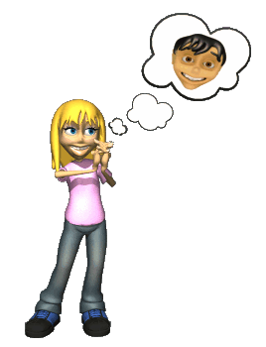
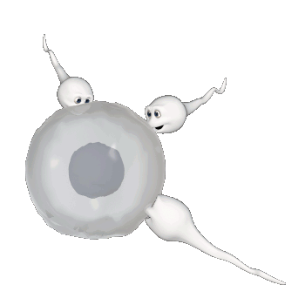
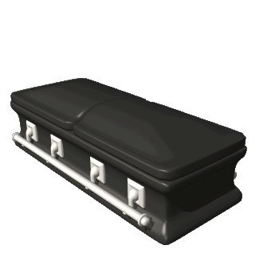
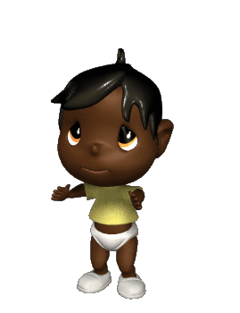
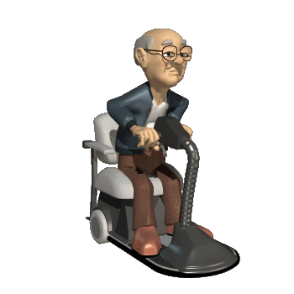
Developmental Psychology
Womb to tomb

Slide 2
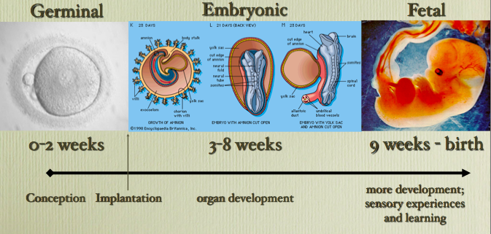
Prenatal Stages of Development
Very important development happens throughout the prenatal stages

Slide 3
Teratogens
Drugs/Alcohol
Maternal Illness
Toxins
Nutrition
Emotions

Slide 4
Learning vs. Instincts
Prenatal learning
Instincts
Newborn’s show preference for mother’s language. Studies show:
Newborn’s cries mimic mom’s accent
Newborn’s show signs of recall for sounds they heard in the womb
Automatic reflexes – helping them survive
Rooting reflex
Sucking
Crying to get food
Preference for faces and human voices
Notes:
Learning
Babies when born show a preference for the mother’s language (babies of bilingual mothers show preferences for both languages)
Newborn’s cries mimic the tuneful signature of the mother’s native tongue (newborn babies have an accent)
Babies in the womb respond to sound and then show signs of recall of the sound after they are born
Instincts – Instinctual automatic reflexes – Helping babies survive
Rooting reflex – When something touches a newborn’s cheek they automatically turn towards it and open their mouth
Sucking – Newborn’s will automatically start sucking on a nipple (real or fake)
Crying when sucking behavior doesn’t result in food
Newborns show a preference for faces and human voices

Slide 5
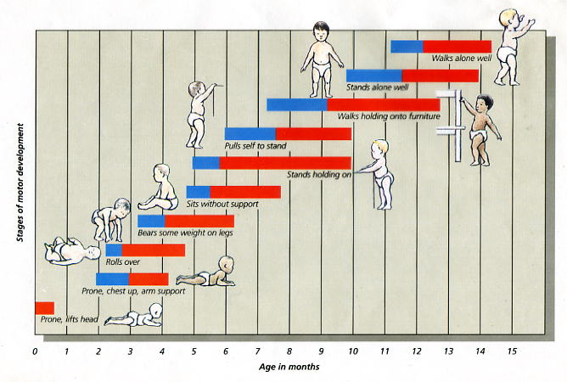
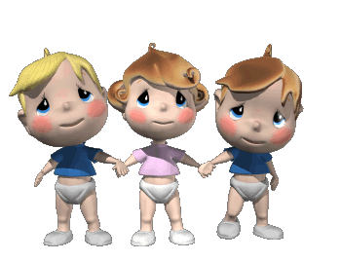
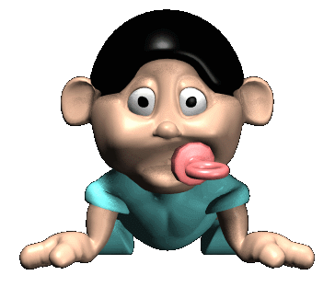
Motor development
Cephalocaudal trend
Proximodistal trend
Maturation
Developmental norms

Slide 6
Temperament Studies
Thomas and Chess
Kagan and Snidman
Easy Children (40%)
Happy children
Regular sleep and eating patterns
Not easily upset
Slow-to-warm-up Children (15%)
Less cheery
Less regular sleep and eating patterns
Slow to adapt to change
Difficult Children (10%)
Glum
Erratic sleeping and eating patterns
Resistant to change
Relatively irritable
Remainder are a mix of these three
Inhibited temperament (15%-20%)
Shyness
timidity
Wariness
Uninhibited temperament (25%-30%)
Not shy
Not timid
Remainder are a mix of these two

Slide 7
Attachment
There is a biological basis for attachment
Babies are programmed to emit behaviors like smiling, cooing, clinging, etc.
These behaviors trigger an affectionate, protective response from adults
Parents are programed to respond with warmth, love and protection
Harlow study on attachment
Patterns of attachment
Secure
Anxious-Ambivalent (resistant)
Avoidant
Disoriented-Disorganized

Slide 8
Erik Erikson
Trust vs. Mistrust
1st year of life
How well does the caregiver meet needs
Autonomy vs. Shame and Doubt
2-3 yrs.
Toilet training and regulating other behaviors
Initiative vs. Guilt
3-6 yrs.
Child experiments and takes initiatives that conflict with parent’s rules
Industry vs. Inferiority
6-puberty
Learning to function socially outside the family unit
Identity vs. Role Confusion
Realize one’s self concept as a unique individual
Embracing an ideology
Intimacy vs. Isolation – Early adulthood
Can a person share intimacy with another
Success means the sharing of empathy and openness
Generative vs. Self-absorption – Middle adulthood
Having a concern for the next generation
Developing a legacy
Integrity vs. Despair – Late adulthood
Not dwelling on mistakes and one’s own death
Finding meaning in your life and satisfaction

Slide 9
Jean Piaget – Cognitive Development
Sensory Motor – 0-2 yrs.
Preoperational – 2-7 yrs.
Conservation
Centration
Egocentrism
Concrete operational – 7-11 yrs.
Formal operational – 11 yrs.
Sociocultural – Vygotsky
Children are not the only active agent in development
Development is not the same across cultures
Language development is not just part of cognitive development but has a vital role in it
Notes:
Sensory Motor
0-2 yrs.
Experience the world through their senses
Child is learning to coordinate their sensory input with their motor function
Developing object permanence
Object Permanence – Realizing that an object still exists even when it is out of view
Preoperational
2-7 yrs.
Conservation - the awareness that physical quantities remain constant in spite of changes in their shape or appearance.
Centration – Focusing on one aspect of a problem neglecting other important facts
Irreversibility – unable to see the reverse of an action
Egocentrism – inability to see from another’s point of view
Animism – everything is alive
Concrete operational
7-11 yrs.
Child masters decentration and reversibility
Gains the ability to see things from a different view
Gradual become less egocentric and develop conservationism
Formal operational
11 yrs.
Apply their cognitive skills to abstract concepts
Develop more adult like thinking abilities

Slide 10
Kohlberg’s Stages of Moral Development
Preconventional level – Self focused
Stage 1 – Punishment orientation
Stage 2 – Naïve reward orientation
Conventional level
Stage 3 – Good boy/girl orientation
Stage 4 – Authority orientation
Post conventional level
Stage 5 – Social Contract orientation
Stage 6 – Individual principles and conscience orientation
Notes:
Kohlberg’s Stages of Moral development are focused on moral reasoning not overt behavior and are derived from Piaget’s theory of cognitive development
Preconventional – Early childhood until adolescence
Convetional – Adolescence on into adulthood
Postconventional – Adults but they argue that many people never reach this stage.

Slide 11
Adolescence
Physiological Changes
Neurological Changes
Pubescence vs. Puberty
Secondary sex characteristics
Primary sex characteristics
White matter increases
Neurons become better insulated with myelin sheaths
Neural pathways are better and quicker
Prefrontal Cortex
Last part of the brain to fully mature
Crucial for:
Planning and organizing
Emotional regulation
Response inhibition

Slide 12
Adolescence – The Search For Identity
James Marcia – Four Identity Statuses
Presence or absence of a sense of commitment to:
Life goals
Values
Sense of crisis – Active exploration and questioning
Identity
Status
Identity Foreclosure
Identity achievement
Identity Diffusion
Identity Moratorium
Sense of apathy
No commitment to ideology
Premature commitment to vision, value and roles
Typically prescribed by parents
Delay commitment
Exploring/experimenting with alternative ideologies and careers
A sense of self and direction after exploration
Commitment
Crisis/Exploration

Slide 13
Transitions in adulthood
Pre-family – Work and family
Adjusting to marriage
Work and Marriage
Financial concerns
Marital roles
Parenthood
Marital satisfaction
Parent contentment
Empty nest
Moms vs. Dads
Parental contentment
Marital satisfaction
Aging adults
Physical changes
Menopause
Neural changes
Cognitive changes – Crystalized vs. fluid intelligence

