Slide 1
Sensation and perception

Slide 2
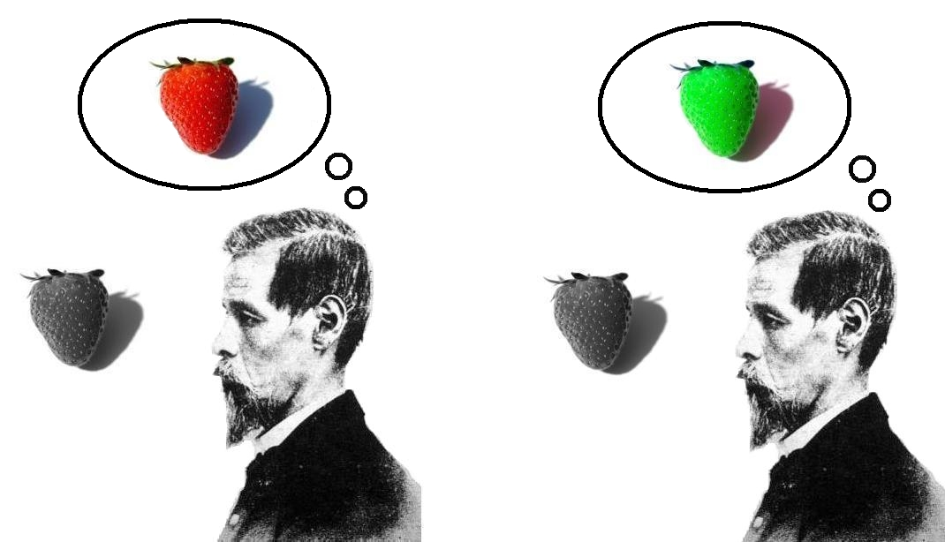
Sensation vs. Perception
Sensation
Perception
The stimulation of the sense organs
The raw data
Nerve impulses
Selection, organization and interpretation of sensory information
How we make sense of the information that comes in
What influences or perception?

Slide 3
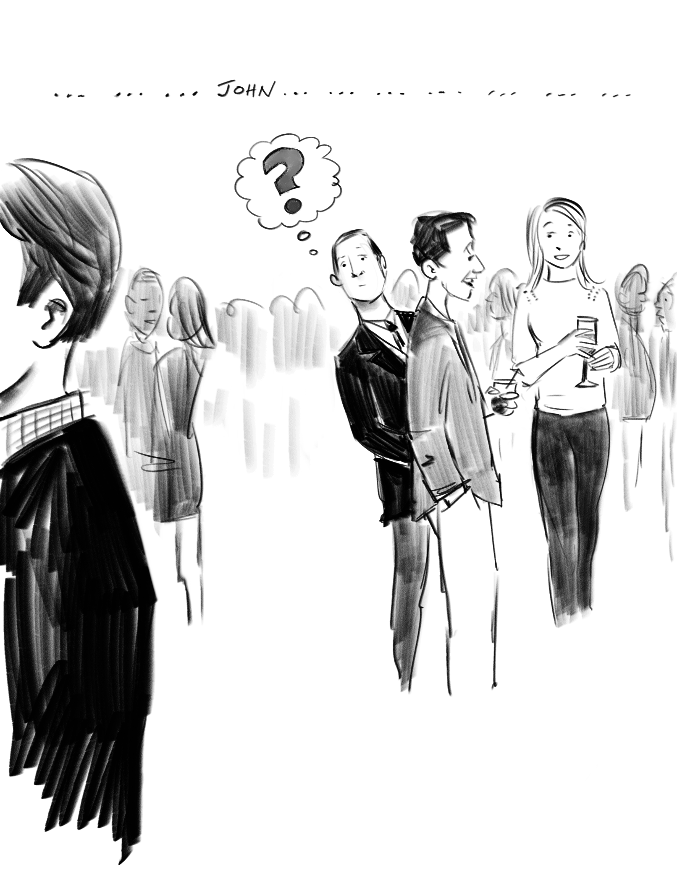
Sensation and Perception
The Basics
Psychophysics – How stimuli are turned into psychological experiences
Transduction – Transforming waves into neurological impulses
Selective Attention
Cocktail party phenomenon
In-attentional blindness
Change blindness

Slide 4
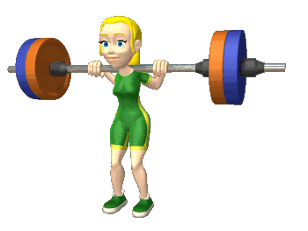
Sensation and perception
Thresholds
Absolute threshold
Just-noticeable-difference (Weber’s Law)
Signal Detection Theory – Detection depends on:
Experience
Expectations
Motivation
Fatigue
Noise
Sensory Adaptation

Slide 5
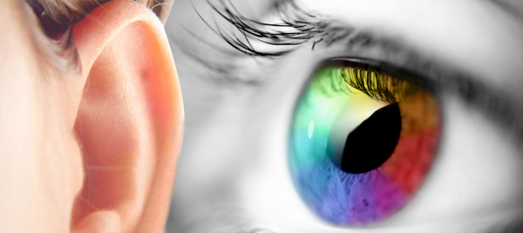
Sensation
Transduction
Vision and Auditory

Slide 6
Vision
Light
Amplitude – Brightness
Wavelength – Color
Purity – Less white
Parts of the Eye
Lens – Focus the image on retina
Pupil – Controls amount of light
Retina – Interprets the image

Slide 7
Vision
Retina
Absorbs, processes image and sends it to the brain
Parts of the retina
Optic Disc
Receptors cells
Rods
Con

Slide 8
Vision
Notes:
Images from inside of each eye pass to the opposite side occipital lobe
Images from outside of the eye go to the same side occipital lobe
The point at which the optic nerve goes one of two ways
The main pathway – Perception of color, form, contrast and motion
Connect to the Lateral geniculate nucleus
The LGN distributes the information to areas in the occipital lobe that make up the primary visual cortex
The second pathway – Perception of motion and coordination of visual input with other sensory input
Goes to an area of the midbrain called superior colliculus
Then travels through the thalamus to the occipital lobe

Slide 9
Vision
Feature detectors – Neurons that respond to very specific features
Ventral Stream
Form
Color
Dorsal Stream
Motion
Depth

Slide 10
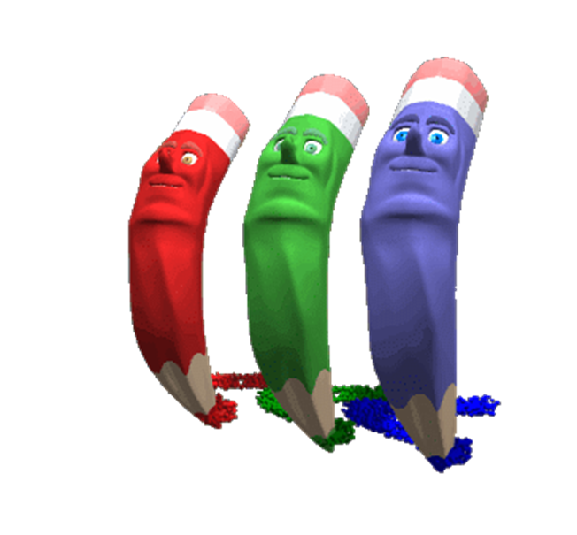
Vison – Seeing color
Trichromatic Color Theory
Opponent Process Theory
Each receptor is sensitive to different wavelengths
Seeing different colors is simply a mixture of these three different color receptors
Red
Green
Blue
The sensory receptors come in pairs.
Red/Green
Yellow/Blue
Black/White
If one color is stimulated, the other is inhibited.

Slide 11
Vision – seeing color Reconciling the theories
They both explain color vision
The cones follow the trichromatic theory
The eye has three types of cones that are sensitive to specific wavelengths (colors)
As we process color in the LGN and visual cortex it follows the Opponent process theory
Neurons respond in opposite ways to:
Red vs. Green
Blue vs. Yellow

Slide 12
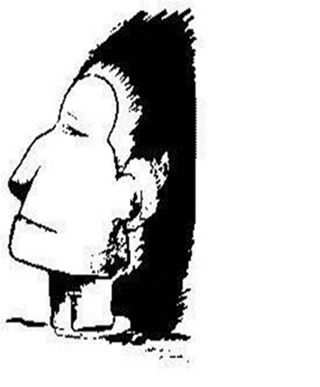
Visual Perception
Influences on perception
Perceptual set
Selection – Attentional blindness
How you organized visual stimuli
Bottom-Up Processing
Feature analysis
Top-Down Processing
I _ant ch_co_ate ic_ cr_am
Subjective countours

Slide 13
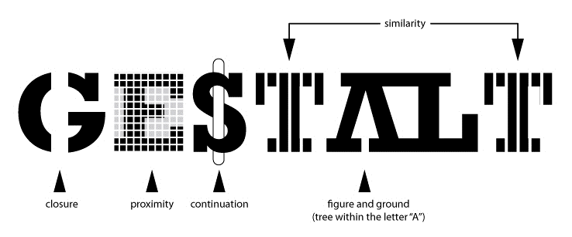
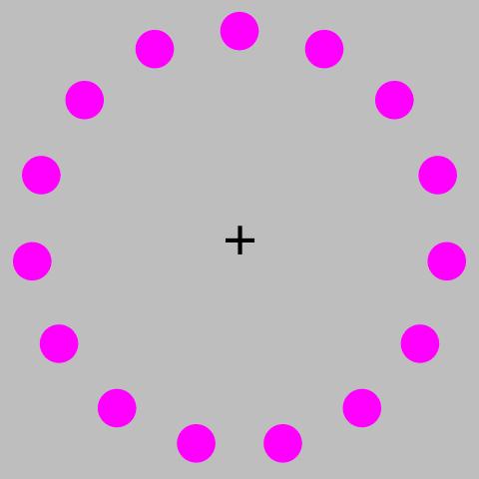
Visual Perception
Dividing visual information into figure and ground
Figure – The thing being looked at
Ground – the background
Proximity – Things that are near each are seen as being together
Closure – we group elements to create a sense of closure
Similarity – We group stimuli that are similar
Simplicity – We group things that make a good figure
Continuity – We group things in a way that create smooth continuations
Phi Phenomenon – Illusion of movement

Slide 14
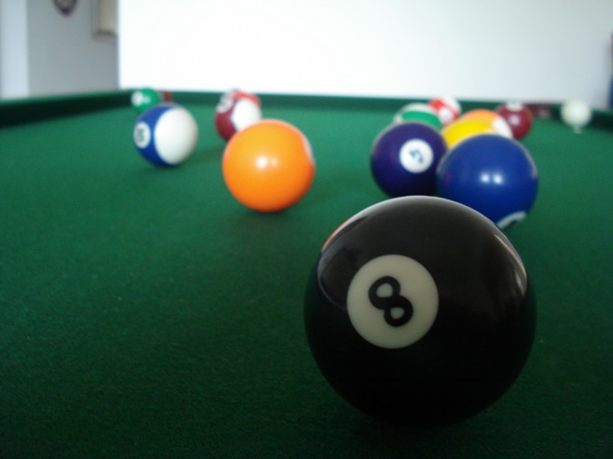
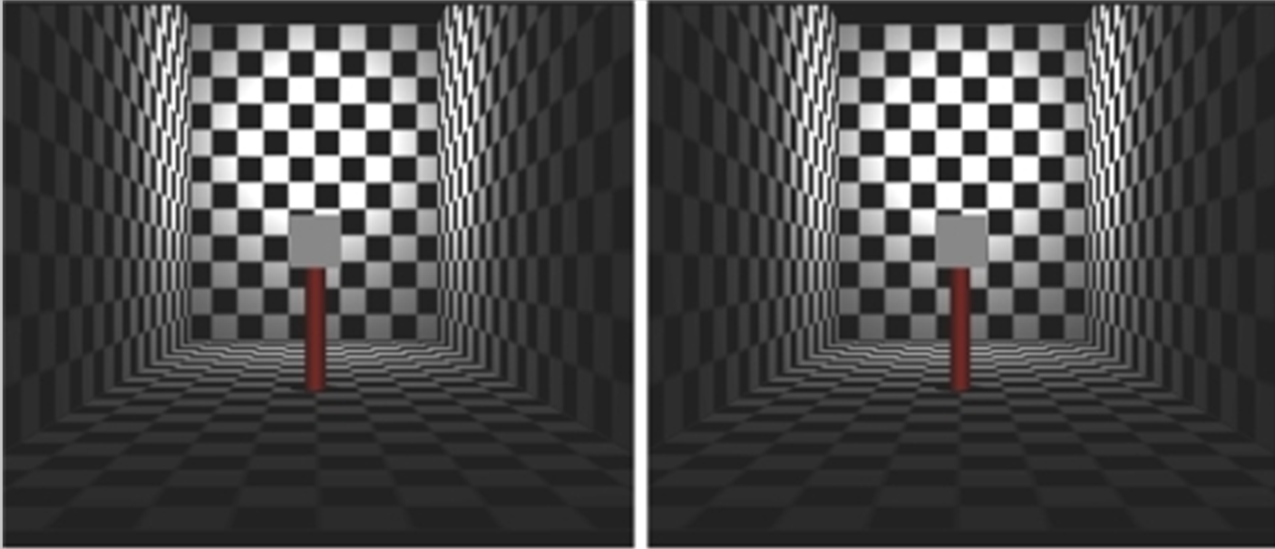
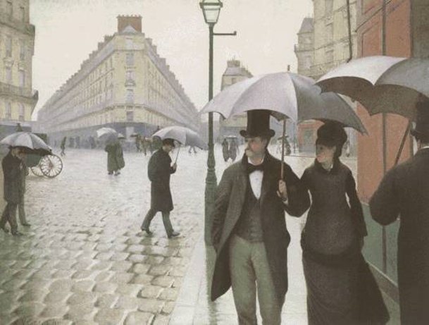
Visual Perception Depth and distance Cues
Binocular Cues
Monocular Cues
Both eyes working together
Retinal disparity
Convergence
Linear perspective
Texture gradient
Interposition
Relative size
Height in Plane
Shadowing

Slide 15
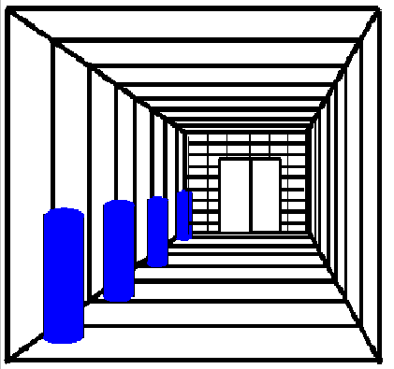
Perceptual Constancies
Objects change in our eyes constantly as we or they move, but we are able to maintain stable perception
Shape Constancy
Size Constancy
Brightness Constancy

Slide 16
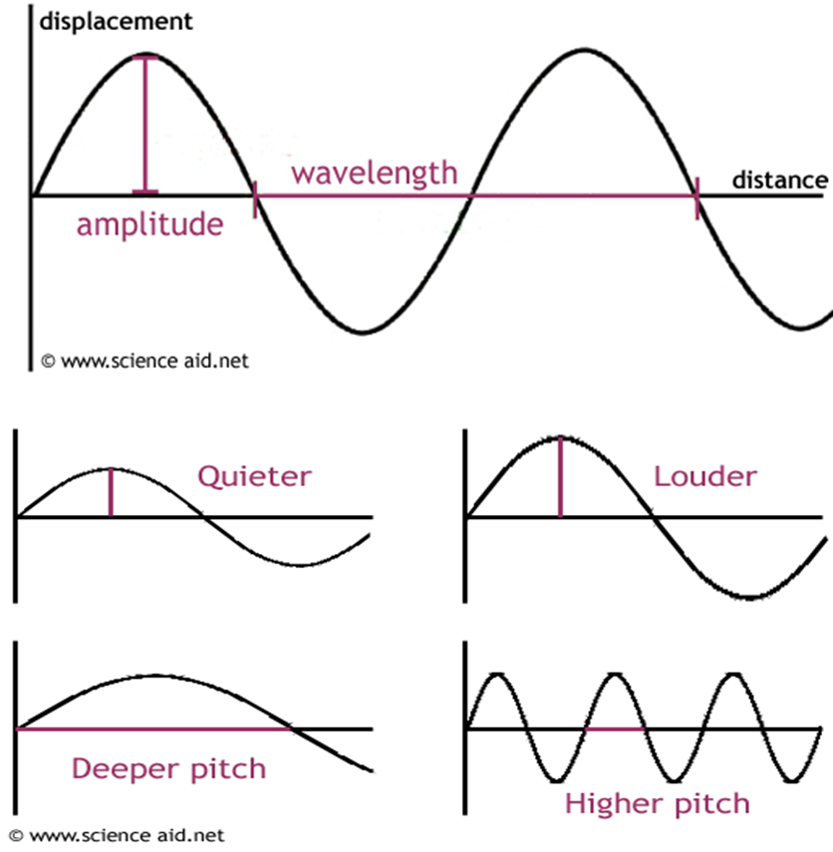
Auditory
Sound Waves
Three Parts of the Ear
Amplitude – Loudness
Wavelength – Pitch
Purity – Timbre (quality)
External Ear – Responds to vibrations of air molecules
Middle Ear – Responds to vibrations of movable bones
Inner Ear – Responds to waves in a fluid

Slide 17
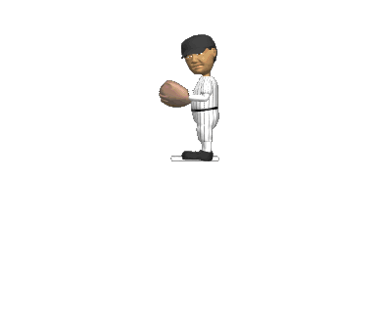
Auditory perception – Pitch theories
Place Theory – Perception of pitch depends on vibrations at different portions (places) along the basilar membrane
Frequency Theory – Perception of pitch is due to the rate at which the entire basilar membrane vibrates.
Reconciling the theories
They both have flaws
Both are valid in part
Sound vibration travels along the basilar membrane but the wave peaks at particular places

Slide 18
Chemical Senses
Taste and Smell

Slide 19
Taste and Smell
Gustatory - Taste
Olfactory – Smell
Taste buds
Tastes – Bitter, sour, sweet, salty and (Unami-savory?)
Olfactory cilia – Smell Receptors
Hair like structures in the nasal passage
They send a neural impulse into the olfactory bulb
The nerve impulse is then routed to the olfactory cortex
Taste and smell work together to produce the sensation of flavor
Ability to detect flavor declines greatly when odor cues are absent

Slide 20
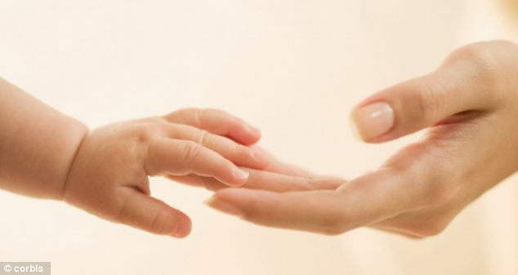
The sense of Touch

Slide 21
Sense of Touch
Physical Stimuli
Feeling Pain
Mechanical – Tactile/pressure
Thermal – Hot/cold
Chemical
Fast pathway
Registers sharp localized pain
Allows us to react quicker
Slow pathway
The pain that you get after initial injury
Lags behind a few seconds

Slide 22
Gate-Control Theory of Pain Perception
Incoming pain signals must pass through a gate
Gate can be closed blocking pain signals
Not an anatomical structure but rather a pattern of neural activity.
What can close it?
Signals from the brain
Attention
Expectations
Signals from peripheral receptors
Endorphins
The bodies natural painkiller
Pain blocker

Slide 23
Kinesthetic and Vestibular Sense
Kinesthetic Sense
Vestibular Sense
Tells us where our body parts are.
Receptors located in our muscles and joints.
Tells us where our body is oriented in space.
Our sense of balance.
Located in our semicircular canals in our ears.

