Slide 1
Bio-psychological
Biological Basis for Behavior

Slide 2
The neuron

Slide 3
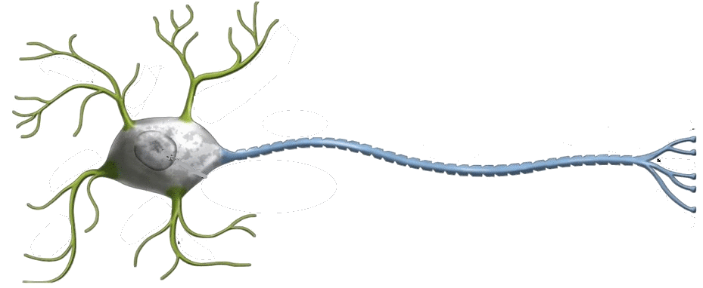
Neurons
Individual cells within the nervous system that receive, integrate, and transmit information.
Dendrite – The Receiver
Soma – Cell Body
Axon – The Transmitter
Notes:
Define the following terms:
Neurons –
Cells that receive, integrate and transmit information throughout the nervous system
Most neurons communicate only with Other Neurons.
Soma –
Cell Body
Cell nucleus
Chemical Machinery common to most cells
Dendrite –
The receiver
The part of the Neuron that is specialized to receive information
Axon –
The transmitter
Long fiber that transmits information to other neurons, muscles or glands

Slide 4
Neuron
The Neuron (Cont’d)
Myelin Sheath – The Covering
Terminal Buttons
Synapse
Notes:
Myelin sheath –
Fatty covering over the axon that speeds up the transmission
Keeps the neurons from cross wiring
Multiple sclerosis –
Disorder caused by deterioration of the myelin sheath
Results in ineffective transmission along the axon
It is a progressive disorder that can eventually lead to death
Terminal buttons –
Small knobs that secrete chemicals called neurotransmitters
These chemicals are the messengers to the other neuron
Synapse –
Junction between two neurons were information is transmitted

Slide 5
Glia Cells
The support crew for the Neuron
Provide nourishment
Remove waste
Provide insulation (wire covering)
Notes:
Define “Glia” –
They are the support cells for the neurons
What are some specific jobs of a glial cell?
Provide nourishment for the neurons
Help remove waste from the neurons
Provide insulation – myelin sheath

Slide 6
Three phases of communication within the neuron
Relative Refractory Period - They could fire the cannon but they would have to work harder and faster!!!!
Notes:
Once the refractory period is over the neuron can fire but it takes more stimulation for a couple of milliseconds until it goes back to resting potential.

Slide 7
All or None Firing
All or None Law
Like a gun
It either fires or it doesn’t
Greater stimulus doesn’t equal a stronger firing
Stronger stimulus might mean more firing s
Notes:
All or None Law –
The neuron either fires or it doesn’t
There is no partial firings or mild fires
It fires the same every time
What changes is the number of firings – The neuron fires more more often when the stimulus is stronger

Slide 8
Depolarization and Polarization

Slide 9
Synapse
Synaptic Cleft
The gap between the terminal button and the dendrite
Presynaptic neuron – The Sender
Postsynaptic neuron – The Receiver
Notes:
Synaptic cleft –
The space between the terminal button and the adjoining dendrite
The space where neurotransmitters pass
Presynaptic neuron –
The sending neuron
Postsynaptic neuron –
The receiving neuron
Neurotransmitter –
Chemicals that transmit information from one neuron to the next
Synaptic vesicle –
Neurotransmitters are stored in small sacs in the terminal button

Slide 10
Pre-Synaptic Neuron
Neurotransmitters
Chemicals that transmit information from one neuron to the next
Stored in synaptic vesicles
Agonists vs antagonists
Agonist – Direct-binding vs. indirect-binding
Antagonist – Direct-acting vs. indirect-acting

Slide 11
Postsynaptic Neuron
Postsynaptic Potential (PSP)
A voltage shift in the postsynaptic neuron at the receptor site
This voltage can vary in strength
Excitatory PSP
Positive voltage shift
Increases the likelihood of an action potential
Inhibitory PSP
Negative voltage shift
Decreases the likelihood of an action potential
After the neurotransmitters do their job they drift away and most are reabsorbed by the presynaptic neuron through reuptake
Notes:
Postsynaptic potential (PSP) –
A voltage shift in the postsynaptic neuron at the receptor site
Excitatory PSP –
Positive voltage shift
Increases the likelihood of an action potential
Inhibitory PSP –
Negative voltage shift
Decreases the likelihood of an action potential
Reuptake –
After the neurotransmitters do their job they drift away and most are reabsorbed by the presynaptic neuron

Slide 12
Nervous system

Slide 13
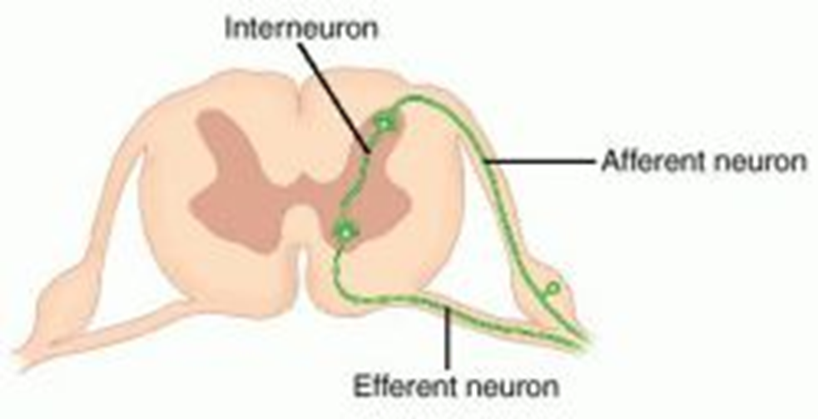
The basic hardware
Nerves
Afferent – From the senses
Efferent – To the muscles
Interneurons – In-between both
SAME
Sensory = Afferent Motor = Efferent

Slide 14
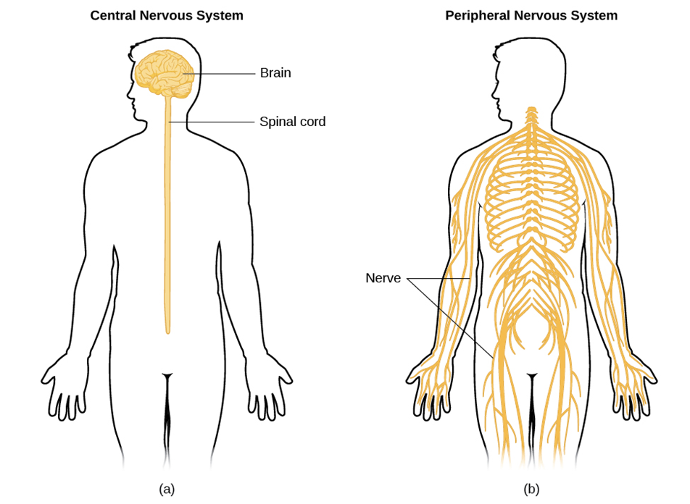
Nervous system
Central Nervous System
Peripheral Nervous System
Brain and spinal cord
All nerves that lie outside of the CNS

Slide 15
The Nervous System
The Nervous System
The Central Nervous System
Brain
Spinal Cord
Peripheral Nervous System
Somatic Nervous System
Autonomic Nervous System
Afferent Nerves
Efferent Nerves
Sympathetic Division
Parasympathetic Division

Slide 16
The Brain and behavior

Slide 17
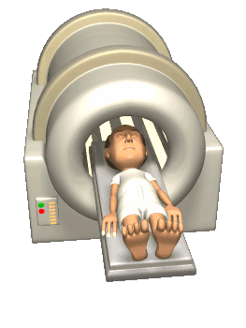
Ways to scan the brain
Electroencephalograph (EEG)
Record brain waves
Good for sleep studies
Lesioning – damaging parts of the brain
Electrical Stimulation of the Brain (ESB)
Transcranial Magnetic Stimulation
Computerized Tomography (CT) – X-ray the brain
Positron Emissions Tomography (PET) – looks at metabolic functioning
Magnetic Resonance (MRI) – Detailed X-ray (3-D)
Functional Magnetic Resonance (fMRI) – Detailed X-ray with functioning

Slide 18
Hindbrain
Brainstem – Crossover point
Medulla –
Vital unconscious functioning
Crossover point for sensory nerves
Pons –
Crossover point for motor nerves
Coordinator of motor functioning
Sleep, dreaming and arousal
Cerebellum
Voluntary movement and balance
Coordination of sensory info with movement
Non-verbal learning and memory
Reticular formation
Modulates muscle reflexes
Breathing
Pain perception
Regulation of sleep and arousal

Slide 19
Midbrain
Integration of sensory processes (filters it)
Origination of dopamine centers
Dopamine centers are involved in voluntary movement and reward system

Slide 20
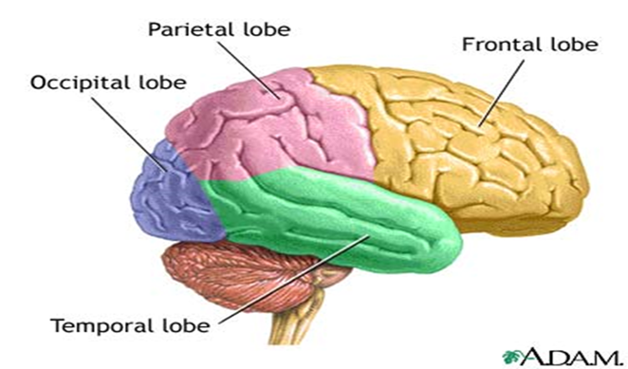
Forebrain
Thalamus – Relay station
Hypothalamus
Controls Autonomic Nervous System
Linked with the endocrine system
Controls the four Fs
Limbic System
Hippocampus – Consolidation of memory
Amygdala – Fear response
Olfactory bulb - smell
Cerebrum – Largest part
Cerebral cortex
Two hemispheres
Connected by Corpus Callosum
Cerebral Cortes – Outer wrinkly part divided into four lobes

Slide 21
Cerebral cortex
Notes:
Occipital lobe
Handles visual sensory information (Primary visual cortex)
Left visual field goes to the right occipital lobe
Right visual field goes to the left occipital lobe
Parietal Lobe
Area that registers the sense of touch (primary somatosensory cortex)
Integrates visual input and monitors bodily position
Temporal Lobe
Primary audio cortex – it is devoted to auditory processing
Frontal Lobe
Primary motor cortex – controls movement of muscles
Mirror neurons - neurons that are activated by performing an action or by seeing another person perform the same action
Allow us to imitate and learn behaviors
Involved in a person experiencing empathy
Prefrontal Cortex – responsible for a wide array of higher-order functioning
Working memory
Reasoning
Some types of decision making

Slide 22
Right brain/Left brain lateralization
All senses except smell crossover including hearing and vision

Slide 23
Each side is still specialized
Left Hemisphere
Right Hemisphere
Specializes in verbal processing
Language
Speech
Reading
Writing
Broca’s Area – Specialized area in the production of speech
Wernicke's area – Important in the comprehension of language
Non-verbal processing
Visual-spatial skills
Musical tasks
Perception of others emotions
Perception of faces
Making Inferences
Making inferences based off language
Modulating our speech in order to make it clear
Orchestrates our sense of self

Slide 24
Dual Processing
At any given moment we have the “high road” working and the “Low road”
High Road
Low Road
Conscious deliberate thought
Ex. I see and eagle flying
EX. I am going to walk down to the office
Unconscious and automatic thought
Ex. The birds color, form, movement, etc.
Ex. The muscle movements involved in walking to the office

Slide 25
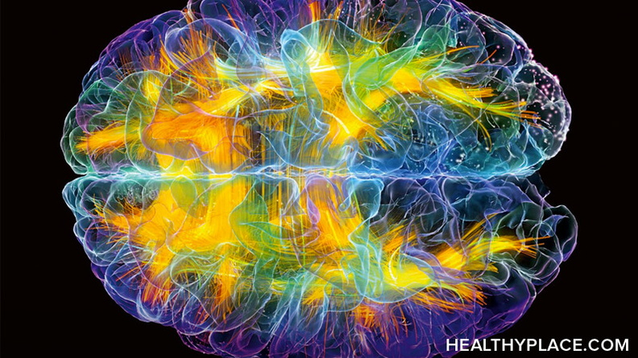
Other Brain Concepts
How do we study brain lateralization
Split brain people – People who have had their corpus callosum severed
Perceptual asymmetry studies – Differences in speed of processing information
Neuroplasticity – Rewiring the brain
Notes:
Studies of split brain people
Due to severe epilepsy people have had their corpus callosum severed
Very few have had it done
Perceptual asymmetry studies
Left brain imbalance between cerebral hemispheres in the speed of visual or auditory processing
Examples
When a face is shown to the right visual field it will take longer to process than if it were shown to the left visual field
When a word is shown to the left visual field it takes longer to process than if shown to the right visual field
Examples
Example 1 – The right eye communicating with the left hemisphere would take longer to recognize faces because it would have to communicate with the right hemisphere
Example 2 – The left eye communicating with the right hemisphere would take longer to recognize language because it would have to communicate with the left hemisphere
Doctors who specialized on split brain studies
Dr. Michael Gazzaniga
Dr. Sperry

Slide 26
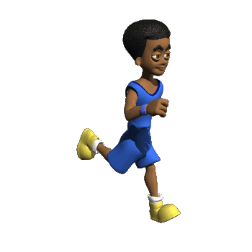
Endocrine System
Chemical messengers are hormones
Sent through blood stream
Hypothalamus is the boss of the Endocrine system
Pituitary gland is like the master gland
Neurotransmitters
Hormones

