Slide 1
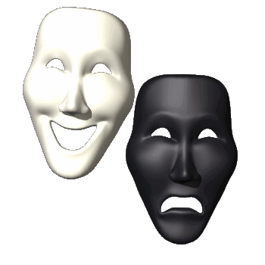
Personality
What makes you the individual
Little snow flake that you are!

Slide 2
The Basics
What is personality
Consistency
Distinctiveness
Traits vs. Types
Trait/situation interaction
Type A
Type B

Slide 3
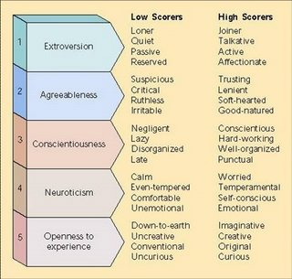
Trait Theory
Raymond Cattell
16 PF – 16 Personality Factors
Source traits
Surface traits
Factor Analysis
Five Factor Model
Extroversion
Agreeableness
Conscientiousness
Neuroticism
Openness to experience

Slide 4
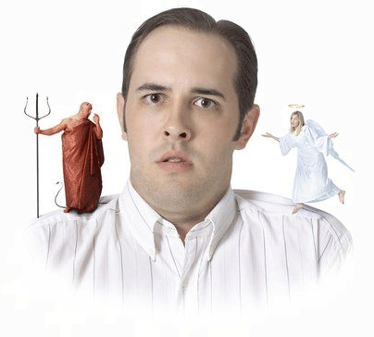
Psychoanalytic Theory – Freud
Three mental structures
Id – Pleasure principle
Superego – Ego ideal
Ego – Reality Principle

Slide 5
Psychoanalytic Theory – Freud
Defense Mechanisms
Psychosexual Stages of Development
Rationalization
Repression
Displacement
Reaction formation
Identification
Sublimation
Regression
Oral Stage
Oral dependent
Oral aggressive
Anal Stage
Anal retentive
Anal explosive
Phallic Stage
Oedipus conflict
Electra conflict
Latency Stage
Genital Stage

Slide 6
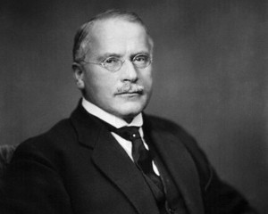
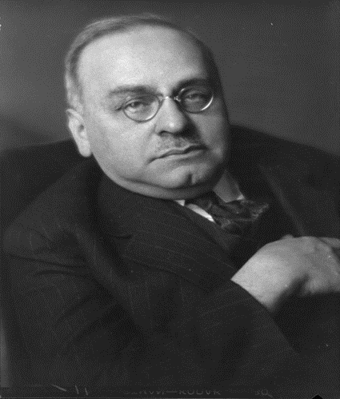
Psychodynamic Theory
Carl Jung
Alfred Adler
Personal unconscious
Collective unconscious
Striving for superiority
Compensating

Slide 7
Behaviorist approach
Personality According to B.F. Skinner
Personality According to Bandura
Personality – product of conditioning
Determinism
Response tendencies
Social Cognitive Theory – Personality shaped through learning
Reciprocal determinism
Observational learning
Self-efficacy
Personality According to Mischel
Person-situation controversy – Both the person and the situation are important
Behavior
Situational factors
Cognitive factors

Slide 8
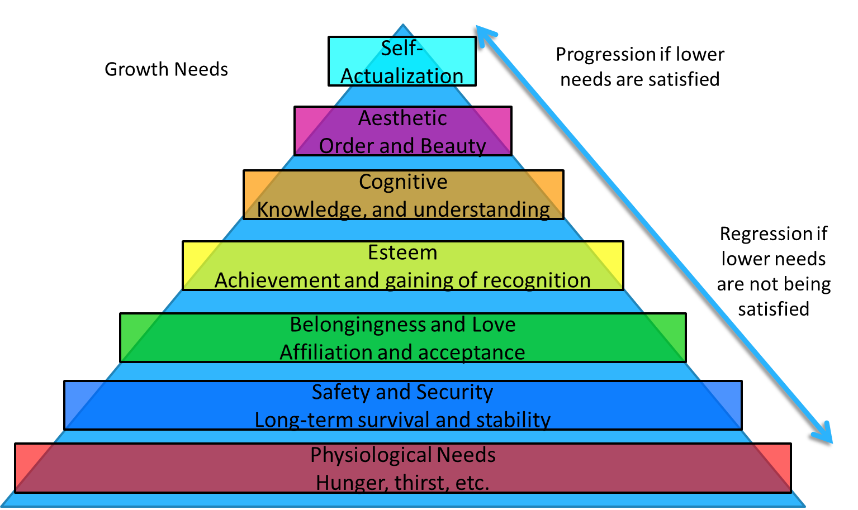
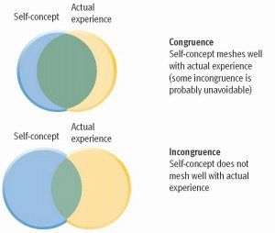
Humanistic theory on personality
Carl Rogers
Abraham Maslow
Self-concept
Congruence
Incongruence
Self-actualization

Slide 9
Biological perspective Nature vs. Nurture
What Causes Personality?
Your Genetics vs. The Way Your Raised

Slide 10
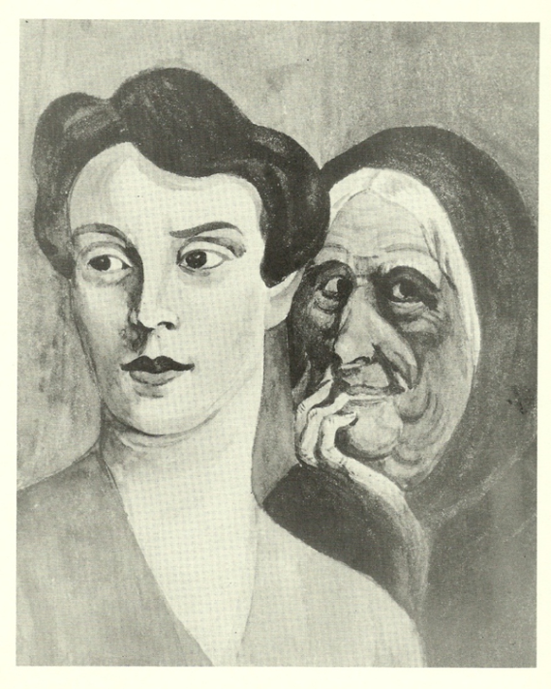
Personality test
Self-Reporting Inventories
Projective Tests
MMPI – Minnesota Multiphasic Personality Inventory
16PF – Based on Cattell’s 16 personality factors
NEO Personality
Rorschach Inkblot Test
Thematic Apperception Test

Slide 11
In summation…
Perspective | Major Theorists | Key Concepts | Roots of Personality
Psychoanalytic | Freud | Psychosexual stages | Unconscious
Humanistic | Rogers, Maslow | Free will self-actualization | Subjective feelings about self
Trait | Costa and McCrae | Big Five, factor analysis | Established patterns of behavior
Sociocognitive | Bandura | Reciprocal determinism | Ways of thinking

