Slide 1
Learning and Cognition
AP Test Review

Slide 2
Learning
Classical Conditioning
Operant Conditioning
Observational learning
Cognitive Learning

Slide 3
Learning
Relatively permanent changes in behavior due to experience
Stimuli
Reinforcement
Response
Antecedents
Consequences
Most basic form of learning is Conditioning
Classical Conditioning
Operant conditioning

Slide 4
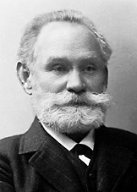
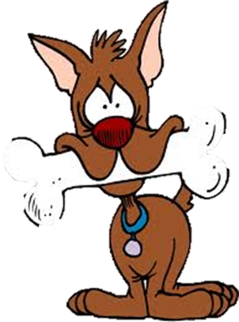
Classical Conditioning
Ivan Pavlov

Slide 5
Classical Conditioning
Classical Conditioning – antecedent events become associated with one another
A stimuli that does not produce a response is associated with one that does
Ex. A horn is coupled with a puff of air to the eye
Ex. A whistle is coupled with a slap to the face
Reflex – non learned response
Ex. Eye blink
Ex. Flinching

Slide 6
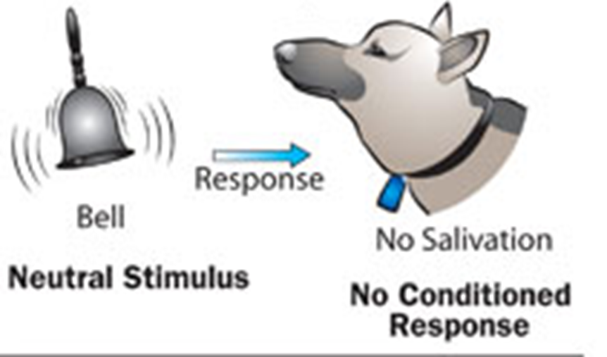
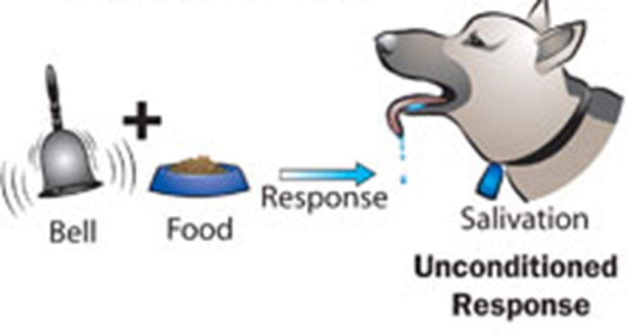
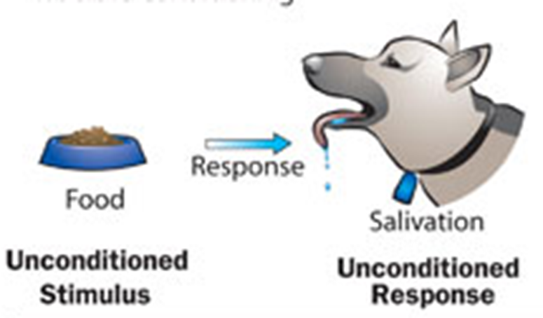
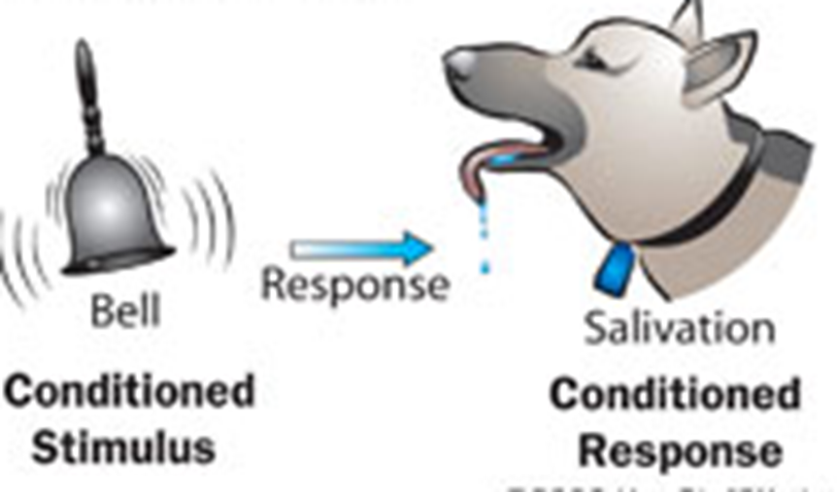
Ivan Pavlov and classical conditioning
Acquisition

Slide 7
Generalization vs. Discrimination
Stimulus Generalization – when a conditioned response occurs with similar stimuli
Stimulus discrimination – being able to tell the difference between two different stimuli

Slide 8
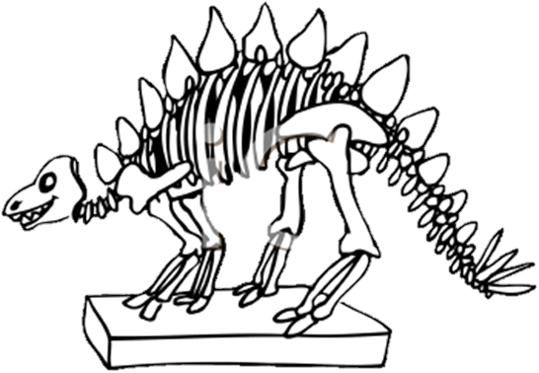
Other Classical Conditioning Concepts
Classical conditioning continued
Extinctions – Non-reinforcement
Spontaneous Recovery
Higher-order conditioning
Vicarious conditioning
Classical conditioning in everyday life
Informational View – Expectancies
Conditional emotional response – Phobias
Evaluative conditioning
Learned taste aversions

Slide 9
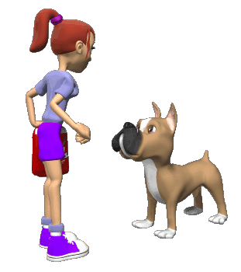
Operant Conditioning
B. F. Skinner

Slide 10
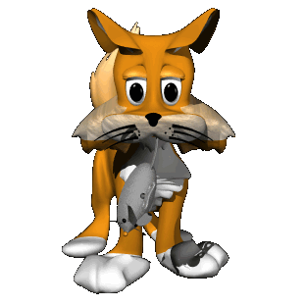
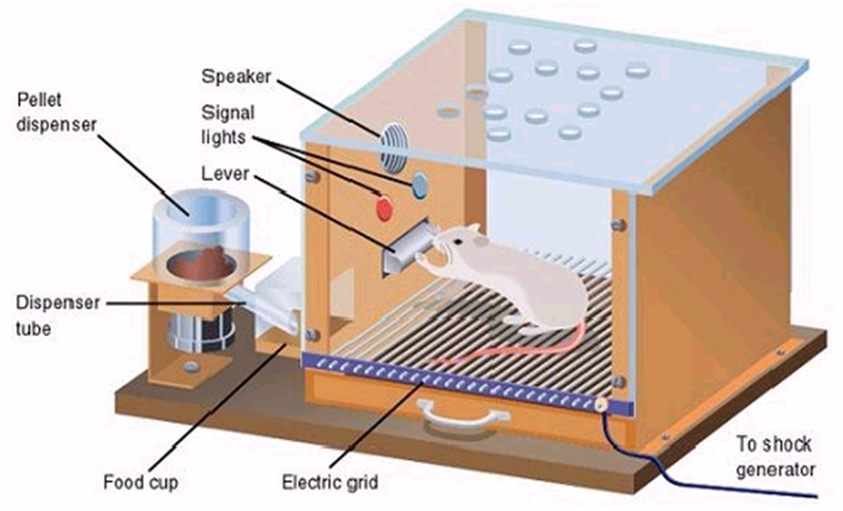
Learning based on Consequences
Edward Thorndike – Instrumental Learning
Types of Consequences
Law of Effect - The probability of a response is altered by the effect it has
Learning is strengthened when it is followed by a favorable response
Reinforcements – Increases the likely hood of a response
Punishments – Decreases the likely hood of a response

Slide 11
Operant Conditioning
Acquiring Operant responses
Basic Process
Response contingent reinforcement
Response contingencies
Types of Reinforcement
Primary
Secondary
Stimulus control
Discriminative stimuli
Stimulus generalization
Stimulus discrimination
Shaping – Response Chaining
Extinction – Resistance to extinction
Schedules of Reinforcement – making a behavior resistant to extinction
Continuous
Partial schedules
Ratio schedules – fixed and variable
Interval Schedules – fixed and variable
Which one is the most resistant and has the best rate of response

Slide 12
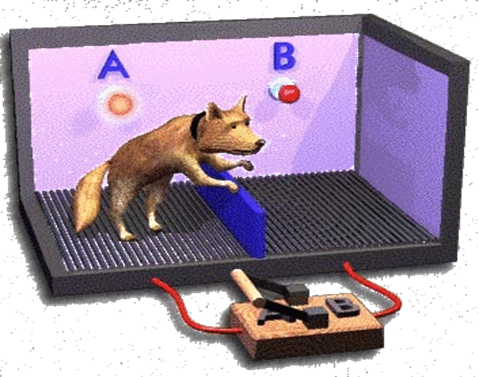
Types of Consequences
Reinforcement – Encourages a behavior to continue
Positive – The giving of something good
Negative – The taking away of something bad
Punishments – Discourages a behavior from continuing
Positive – The giving of something bad
Negative – the taking away of something good
Effects of punishment and reinforcement
Escape learning
Avoidance learning

Slide 13
New theories on Learning
Evolution
Cognitive Learning

Slide 14
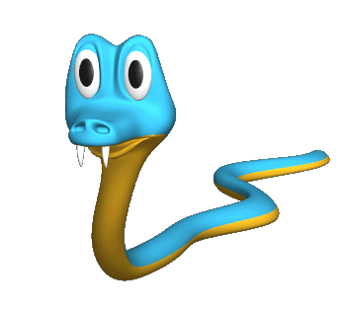
Evolution and cognitive learning
Learning and Evolution
Cognitive Learning
Learned taste aversion
Survival predisposition
Phobias – Preparedness
Latent Learning
Cognitive Maps
Discovery Learning
Observational Learning

Slide 15
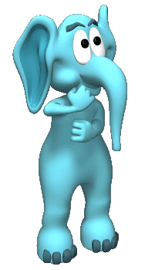
Cognition
Memory

Slide 16
Memory and Encoding
What is Memory?
Encoding
Active system that receives, organizes and stores
Encoding
Storage
Retrieval
Attention – Selective Attention
Early set selective attention
Late set selective attention
How will you remember all this? Depends on your level of processing.
Structural processing
Phonemic processing
Semantic processing
Processing gets deeper with each one!
Enrich encoding
Elaborate
Visual imagery – map technique
Self Referent encoding
Motivate yourself to remember

Slide 17
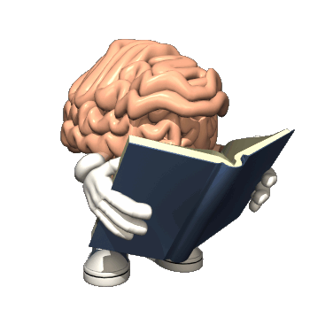
Stages of memory
Sensory Memory
Short-Term Memory
Long-Term Memory
Procedural/Non-Declarative
Implicit Memories
Declarative Memory
Explicit Memories
Semantic Memory
Episodic Memory

Slide 18
Your Memory System
Rehearsal/Elaboration
Selective Attention
Sight
Sensory Memory
Sound
Short-Term
Memory
Long-Term
Memory
Taste
Touch
Working
Memory
Smell
Forgetting
Notes:
Order of animation
Senses (small boxes)
Sensory Memory
Selective attention – early set, to late set and back to early set
Forgetting
Short-Term Memory
Forgetting (Flashing)
Rehearsal/Elaboration
Long-Term Memory
Working Memory

Slide 19
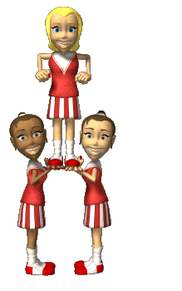
Memory concepts
Consolidation of Memories - Hippocampus
Constructive Processing
Pseudo Memories
Misinformation Effect – Elizabeth Loftus
How memories are stored
Conceptual Hierarchy
Schemas
Clustering
Semantic networking – Redentigrative memory

Slide 20
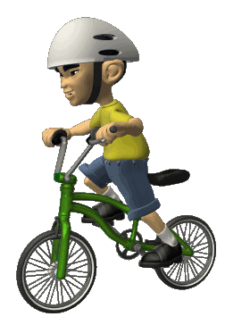
Retrieval
Feeling of knowing – Tip-of-the-tongue
Retrieval cues
Context cues
Mood congruent recall
State dependent learning
Memory monitoring
Reality
Source
Destination
Eidetic Memory – Photographic Memory

Slide 21
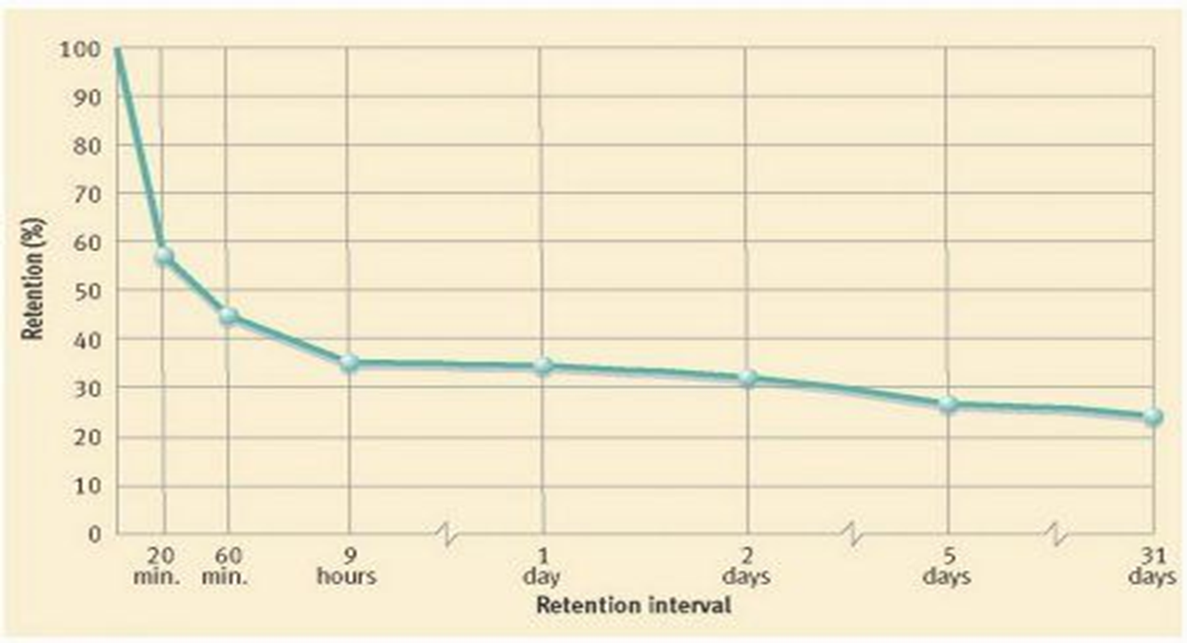
Forgetting
Curve of forgetting – Ebbinghaus
Measures of Memory
Recall task – Serial position effect
Recognition task - Distractors
Relearning task – Savings Score
Why we Forget
Ineffective encoding – pseudo-forgetting
Decay vs. Disuse
Interference – Proactive vs. retroactive
Retrieval failure
Missing cues
Encoding specificity principle
Transfer appropriate processing
Repression vs. Suppression

