Slide 1
Introduction and Research
AP Test Review

Slide 2
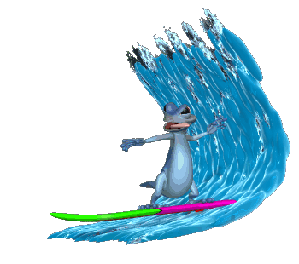
Waves of psychology
Changes in the Study of Behavior

Slide 3
First wave – Focus on the Mind
Structuralism –The Structure of thought
Functionalism – The function of the mind
Wilhelm Wundt
Edward Tichner
G. Stanley Hall
William James
Christine Ladd-Franklin
Mary Calkins
Margaret Washburn
Francis Sumner

Slide 4
Second wave – focus on the unconscious Mind
Psychoanalytic Theory
Unconscious mind
Sigmund Freud
Neo-Freudians – Psychodynamic Theory

Slide 5
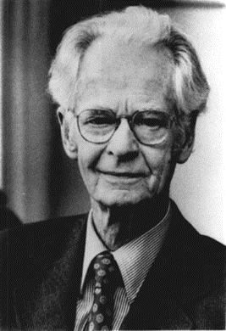
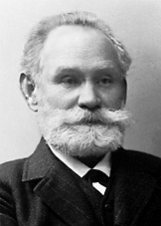
Third Wave – Focus on observable behavior
Behaviorism
Focusing on observable behavior
John B. Watson
Ivan Pavlov
B.F. Skinner

Slide 6
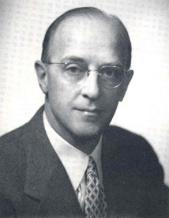
Fourth Wave - Humanism
Humanism
Focus on the human experience
Free-will and personal growth
Abraham Maslow
Carl Rogers

Slide 7
Fifth Wave – Eclectic
Eclectic psychology
Other important approaches
Psychodynamic approach
Behavioral approach
Cognitive approach
Bio psychological approach
Sociocultural approach
Evolutionary approach
BioPsychoSocial approach

Slide 8
The Study of Behavior
Psychology as a Science and an Applied Field

Slide 9
Psychology as a science vs. an applied Field
Psychology as a science
As an applied field
Developmental psychologist
Social psychology
Educational Psychology
Health Psychology
Physiological Psychology (Biopsychology)
Cognitive Psychology
Psychometrics
Personality
Psychologist
Clinical
Counseling
Psychiatrist
Psychoanalyst
Industrial and Organizational Psychologist
Forensic Psychologist
Sports Psychologist
Human Factors/Environmental Psychologist

Slide 10
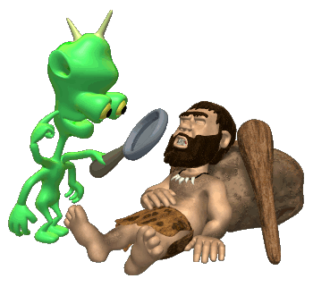
Research Methods

Slide 11
Terminology
Empirical evidence
Hypothesis
Theory
Scientific Method
Purpose
Hypothesis
Conduct and collect data
Analyze data
Conclude
Research Methods
Experiments
Observation
Clinical/case studies
Survey method
Correlational method

Slide 12
Experimental method
Experimental Group
The group your going to mess with
Control Group
The comparison group
The groups are chosen through Random Assignment
Independent variable
Whatever is being manipulated in the experiment.
Dependent variable
Whatever is being measured in the experiment.
Extraneous variables
Confounding variable

Slide 13
Naturalistic observation
Observational record
Errors in observations
Hawthorne Effect
Anthropologic Error
Observer Bias

Slide 14
Clinical and Case Study
Clinical Study
Case Study
Long-term in-depth study of issues that have clinical significance
Limits
Lack of a formal control group
Can’t control variables
Why use it?
Unethical
Unimaginable
Long-term in-depth look at a group or an individual
Limits
Lack of a control group
Can’t control variables
Doesn’t always apply to larger population
Types of case studies
Longitudinal
Cross sectional

Slide 15
Survey Method
Public polling technique used to answer psychological questions
Sampling
Comprehensive sample
Representative sample
Cross-sectional sample
Random sample

Slide 16
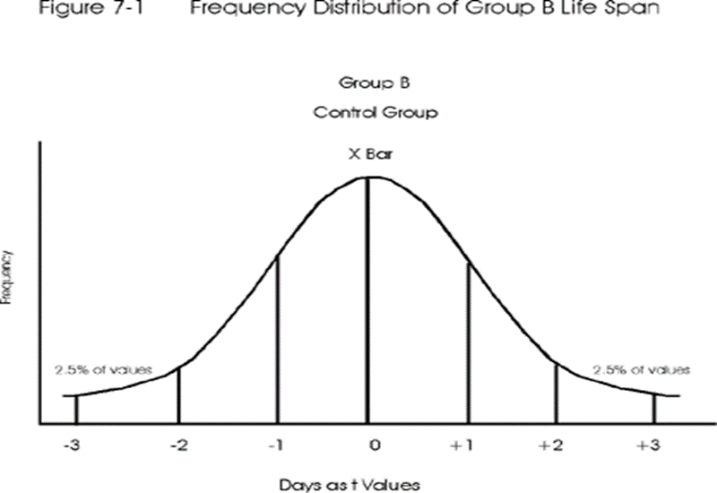
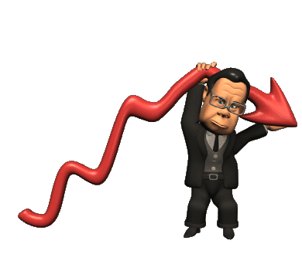
Analyzing Data
Measures of central tendencies
Mean
Mode
Median
Frequency distribution
Range
Normal bell curve
Positive skew vs. negative skew

Slide 17
Correlations
Correlation expresses a relationship between two variable.
Positive correlation
Negative correlations

Slide 18
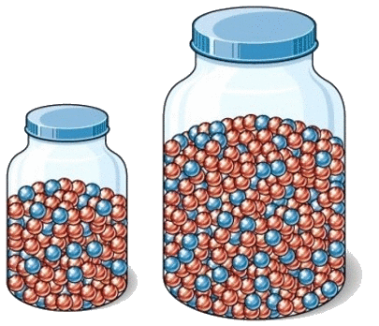
Other useful statistics
Standard deviation
Z-Score
Inferential Statistics
The purpose is to discover whether the finding can be applied to the larger population from which the sample was collected.
Statistical significance P=.05

Slide 19
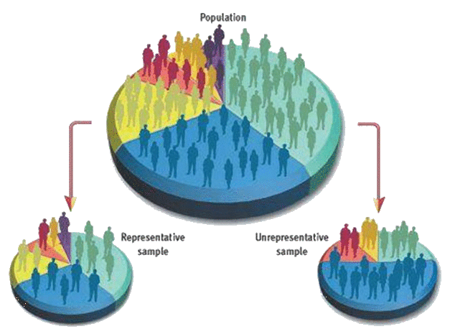
Errors in Research
Sampling bias
Placebo effect
Single blind study
Experimenter effect
Double blind study
Strengthening results
Replication
Meta-analysis

Slide 20
APA ethical guidelines
Human Research
Animal Research
Informed consent
Deception – Can not invalidate the informed consent
No Coercion- must be voluntary
Anonymity
No significant risk – Mental or physical
Must debrief
Clear purpose
Treated in a humane way
Acquire animals legally
Least amount of suffering possible.
All animals must be supervised by a trained psychologist

